Slide 1
Client Platform Usage Tracker
MONTH / YEAR

Slide 2
Client Platform Usage Tracker month.year
Executive Summary
In July 2023, a total of 269 users accessed the XYZ platform. Monthly usage is down for the third straight month, and is off 18% from the record high set in April of this year. However, new user account creation rebounded in July, with 65 new accounts added, up from 39 – a yearly low – in June.
John Doe, Senior Manager for Data Solutions at Company X, emerged as the prominent user of our platform this month. Coming off the currency partnership with Company X announced back in the fall of 2022, John first logged into the platform in May, but it wasn’t until this past month that she started to utilize it in a meaningful capacity. Over the course of the month, he spent approximately 17 hours in the platform, exploring investment plans (149 instances) within the planner app. He also downloaded the Investment Plans: Delivery data 43 times for off-platform analysis.
Users spent an average of two hours and six minutes in the media buyers application in July, the highest total average we have seen from users since we started tracking merged company data. For the fourth consecutive month, the XYZ team combined to spend over 70 hours in the platform, with Jane Doe spending over 48 hours alone. Jane’s heightened usage aligns with the ongoing model refreshes within the XYZ team and the company’s commitment to being fully self-service.
Key highlights from July include:
Billy Johnson, Director of Investment Solutions at ABC company, is a top user for the second straight month, spending nearly 15 hours on the platform, most of which was confined to the Measure app where he interacted heavily with initiative audiences (82 times) and downloaded data about 112 times from the performance breakdown table and attribution discovery chart.
There has been a steady decrease in initiative creation and overall Measure usage over the past few months. However, user behavior seems to be in line with the seasonal patterns we’ve seen in previous years, with initiative engagement peaking during the upfront season and gradually declining as summer advances. In July, exploration of initiatives dipped to it lowest point (723) since December 2022 (457).
Cross Platform Planner app usage has also retreated as upfront planning is now behind us. Typically, planning activity peaks between February and May, and this year was no different.

Slide 3
External Platform Usage – Top Line Metrics
March 2023
July 2023
Month, year
VideoAmp
Elsy
RaaS (Tableau)
269 / 98 / 16
Total Users / Active / 1st-time Active
50 / 31
Total Users / Active Users
110 / 40
Total Tableau Users / Active
42m 29s
Avg. Time in Platform
3.21 days
Avg. Days in Platform
20
Plan Overview Report Users
7m 15s
Avg. Time Spent in
Plan Overview Report
2130
Total Reports Accessed
3.55 days
Avg. Days in Tableau
113
Initiatives Launched
723
Initiatives Explored
21
Plan Comparison Report Users
1h 09m
Avg. Time Spent in
Plan Comparison Reports
12 / 2
CARD Users / Active
59
CARD Reports Accessed
43
Linear Plans Run
152
Linear Plans Explored
12
Campaign Performance Report Users
44m 55s
Avg. Time Spent in
Campaign Performance Reports
260
Users only in platform
101
Users only in Tableau
9
Users in both platform and Tableau
26
Cross Platform Plans Run
379
Cross Platform Plans Explored
11
Campaign Monitoring Report Users
13m 17s
Avg. Time Spent in
Campaign Monitoring Reports

Slide 4
VideoAmp Platform Usage

Slide 5
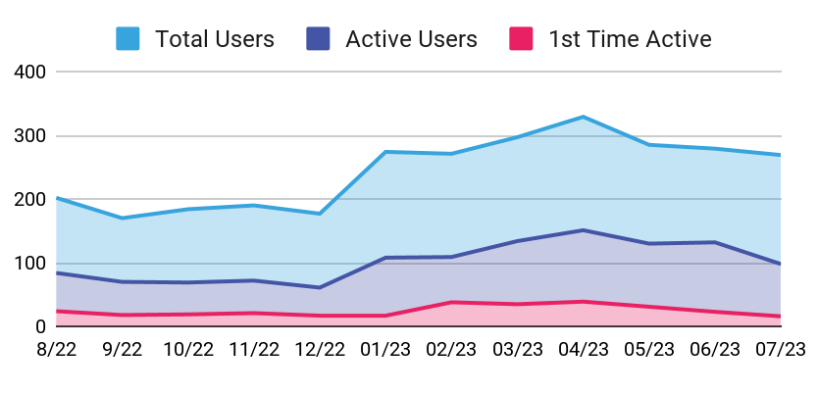
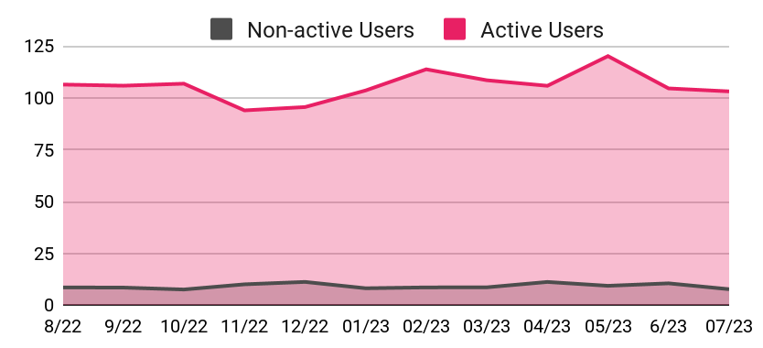
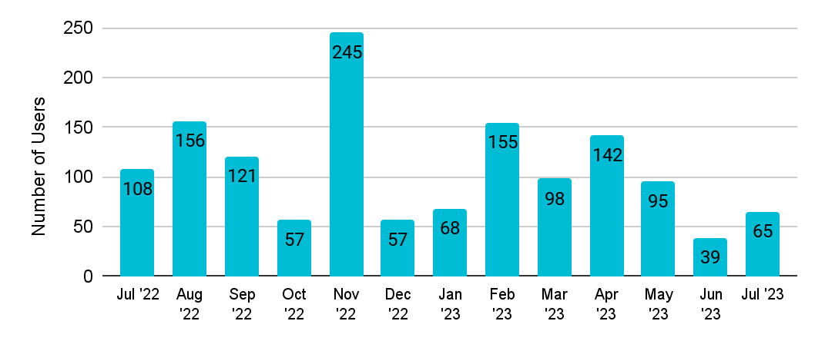
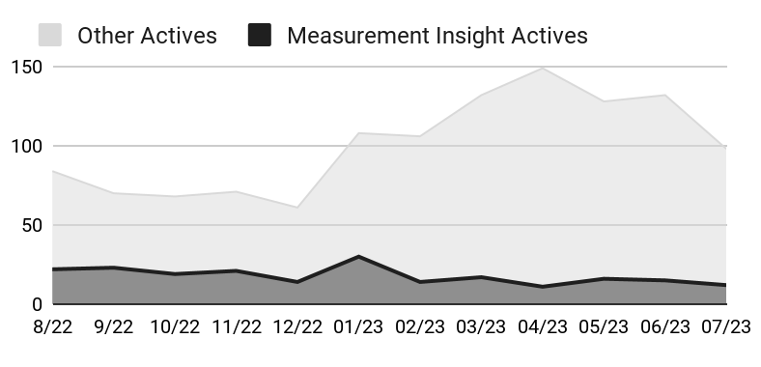
VideoAmp Platform Usage – All Users
April 2023
May 2023
June 2023
July 2023
Month, year
269 / 98 / 16
Total Users / Active / 1st-time Active
42m 29s
Avg. Time Spent in Platform
3.21 days
Avg. Days Spent in Platform
Clients in the Platform
Avg. Time Spent In Platform (min)
Number of User Accounts Created
Active Users by Client Type
Top Users by Time in Platform
Top Users by Days in Platform
Rank | User | Org | Time
1 | Jane Doe | FOX | 17h 01m
2 | John Doe | OMG | 14h 51m
3 | Billy Johnson | OMG | 9h 40m
4 | Deshaun Smith | Dentsu | 8h 39m
5 | Will James | Chewy | 7h 36m
Rank | User | Org | Days
1 | Will James | Chewy | 20
2 | John Doe | OMG | 20
3 | Deshaun Smith | Dentsu | 18
4 | Billy Johnson | OMG | 18
5 | Zach Wills | Dentsu | 17

Slide 6
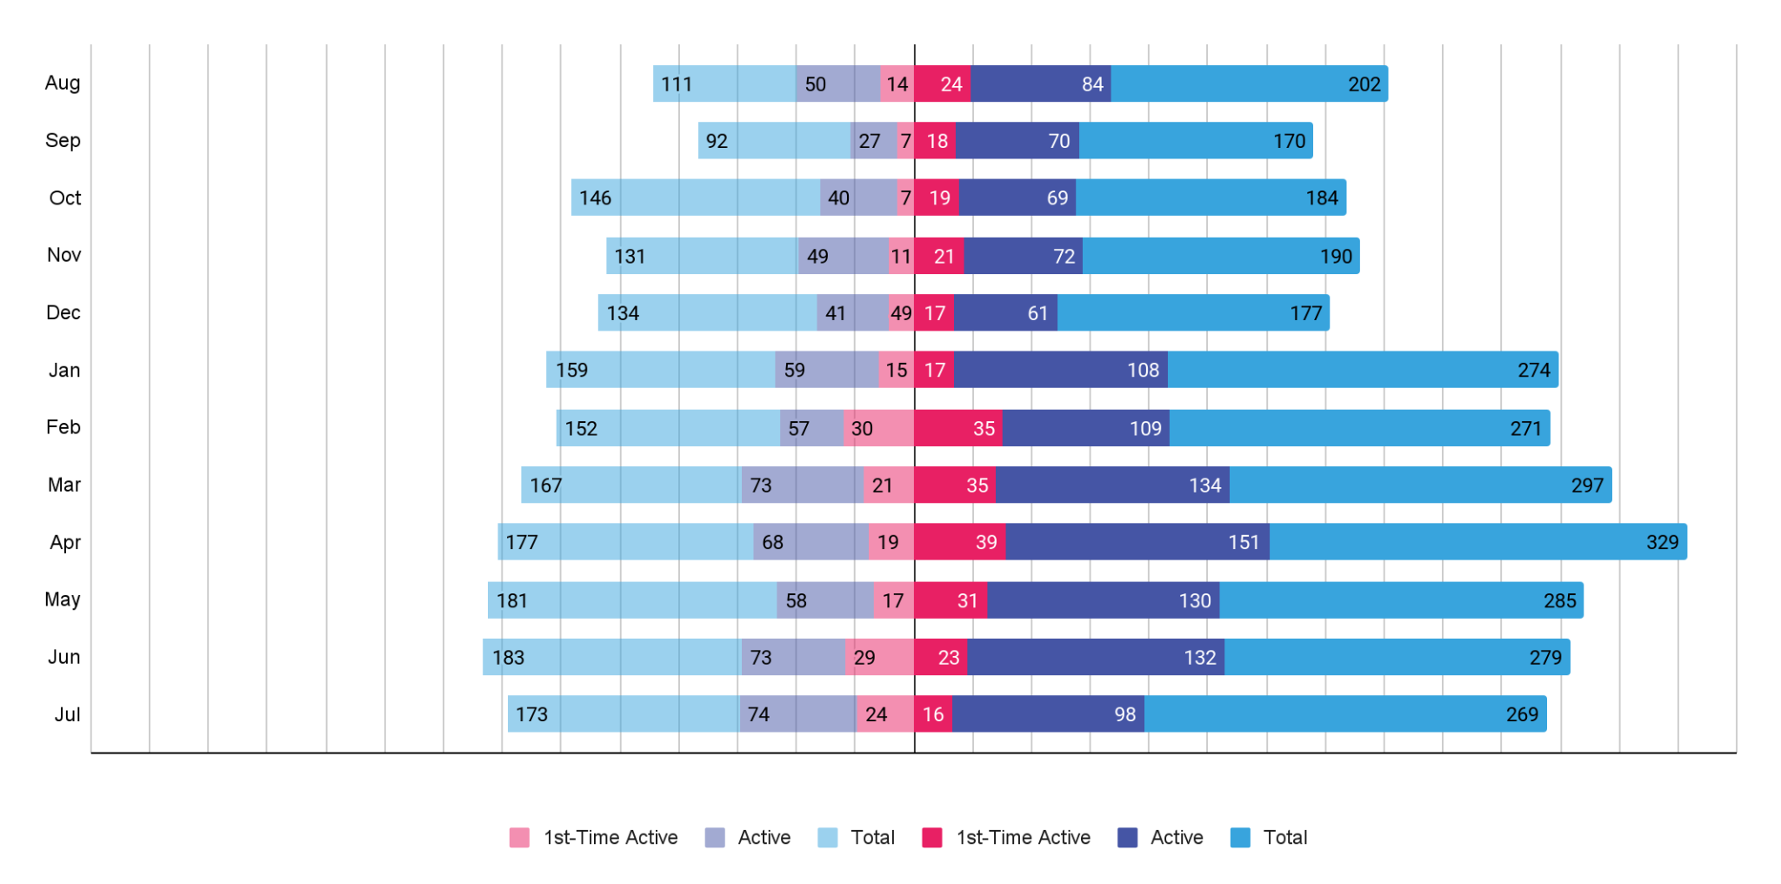
VideoAmp Platform Usage – Clients in the Platform YoY
December 2022
January 2023
February 2023
March 2023
April 2023
May 2023
June 2023
July 2023
Month, year
Aug ‘21
Sep ‘21
Oct ‘21
Nov ‘21
Dec ‘21
Jan ‘22
Feb ‘22
Mar ‘22
Apr ‘22
May ‘22
Jun ‘22
Jul ‘22
Aug ‘22
Sep ‘22
Oct ‘22
Nov ‘22
Dec ‘22
Jan ‘23
Feb ‘23
Mar ‘23
Apr ‘23
May ‘23
Jun ‘23
Jul ‘23
350
300
250
200
150
100
50
0
50
100
150
200
250
300
350

Slide 7
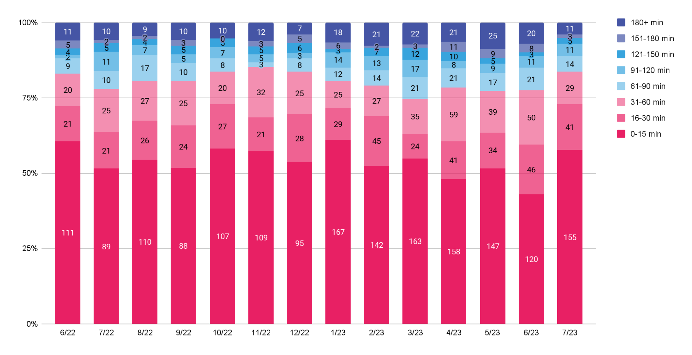
VideoAmp Platform Usage – Time in the Platform
October 2022
December 2022
January 2023
February 2023
March 2023
April 2023
May 2023
June 2023
July 2023
Month, year

Slide 8
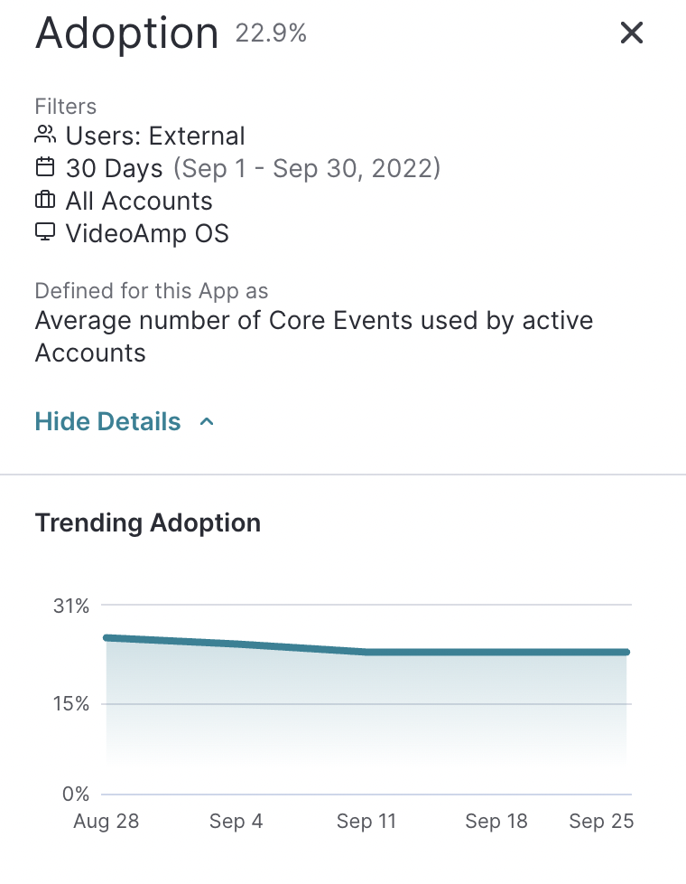
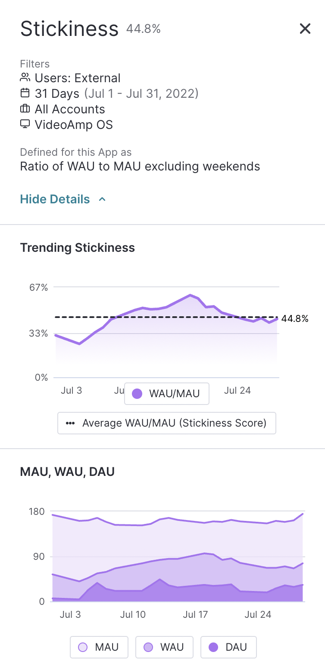
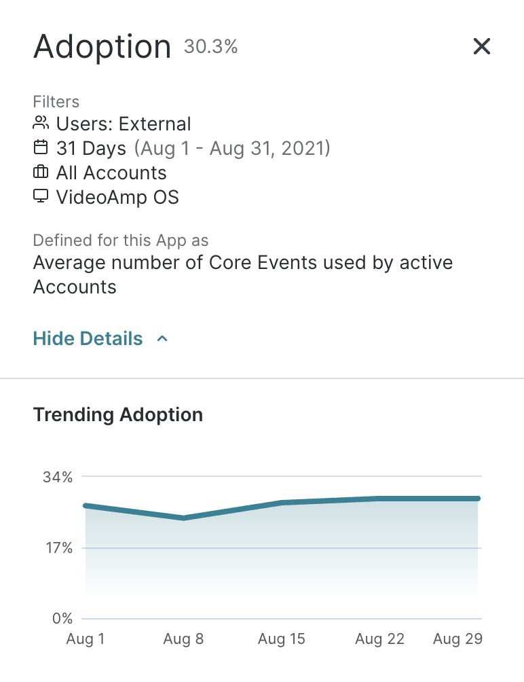
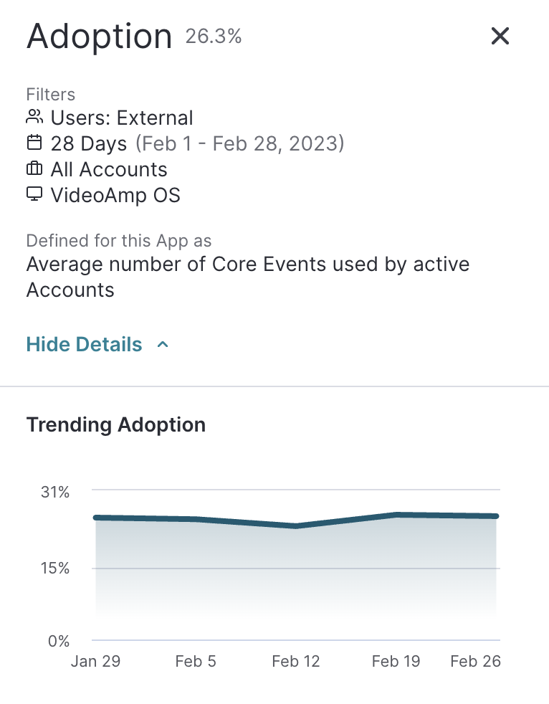
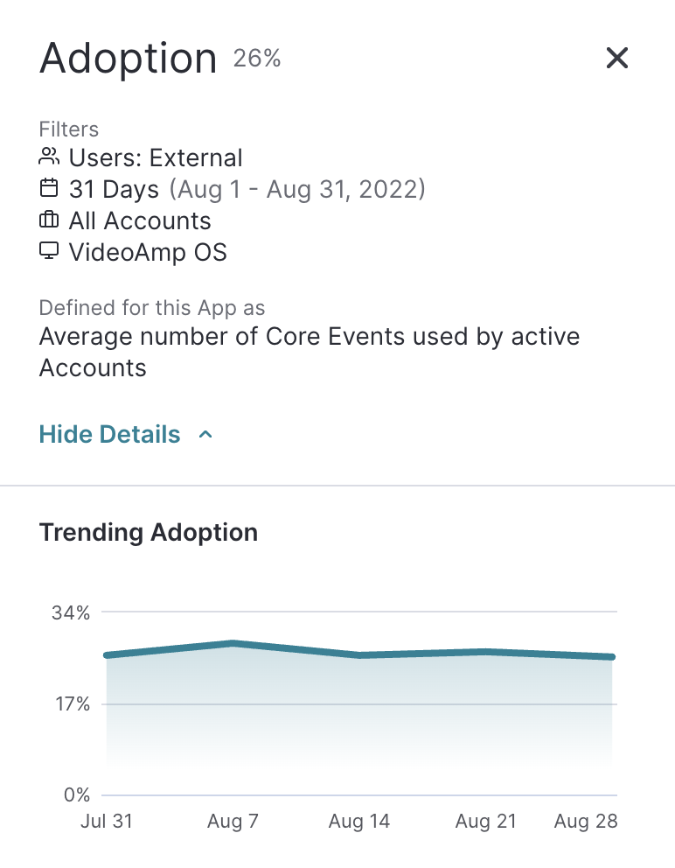
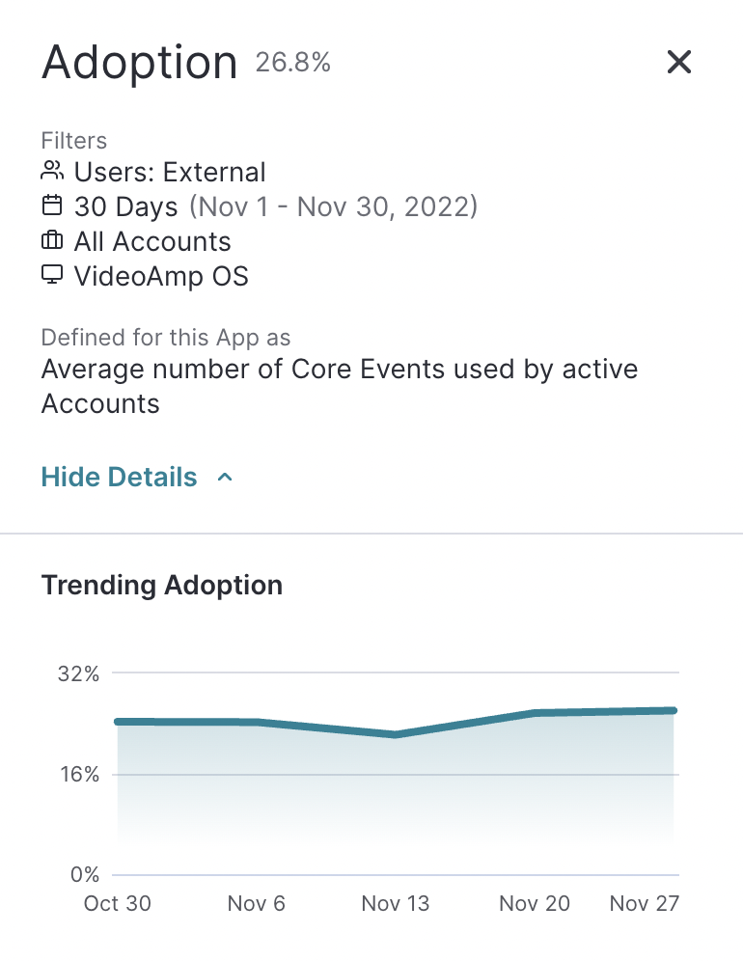
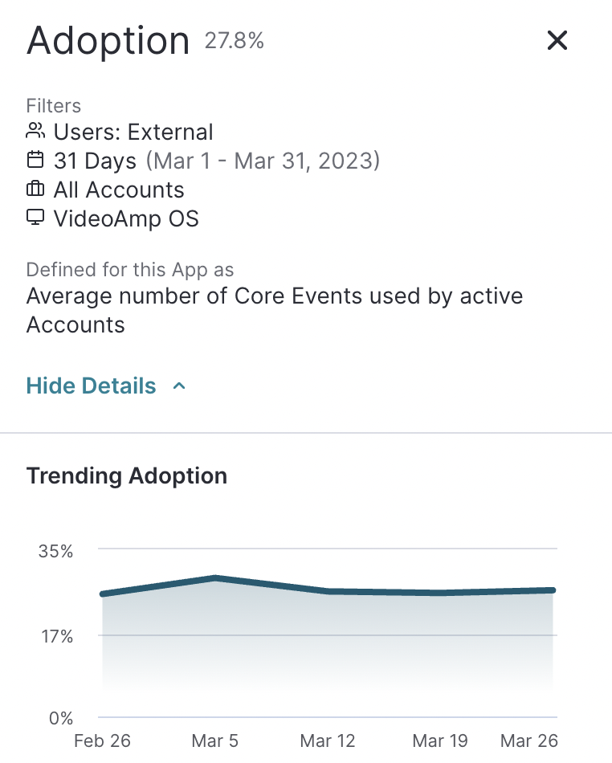
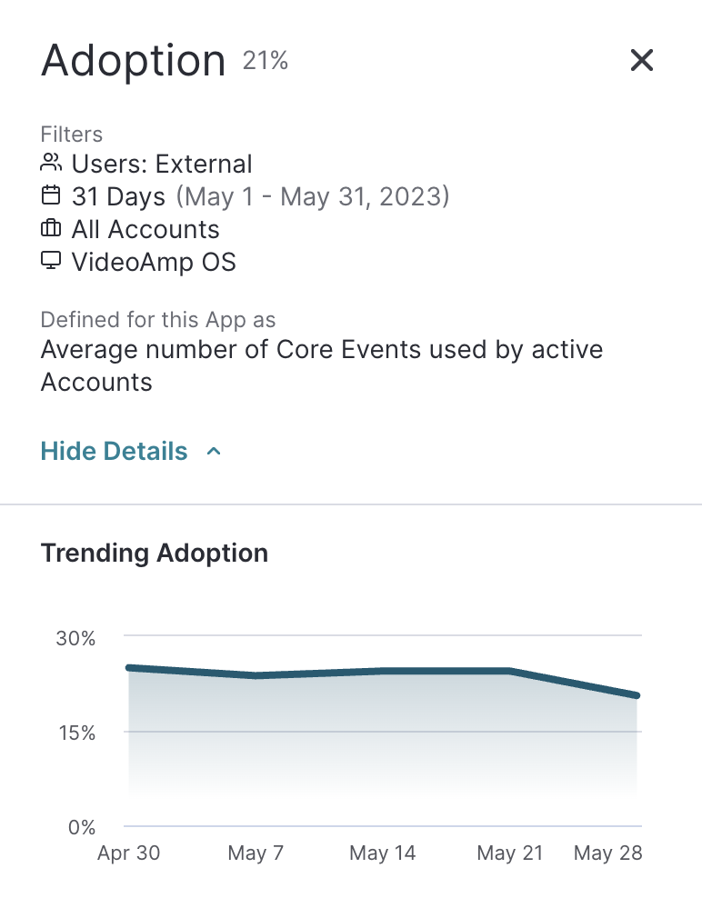
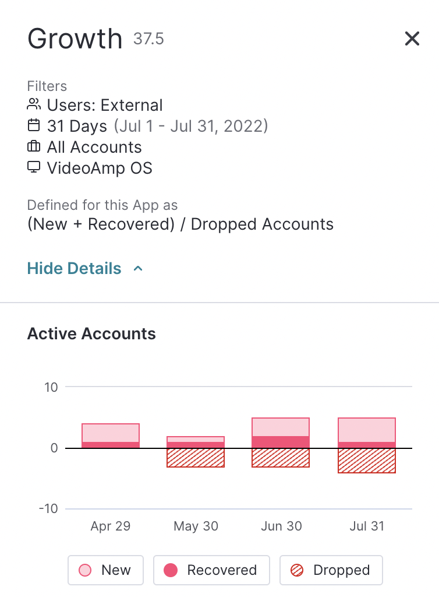
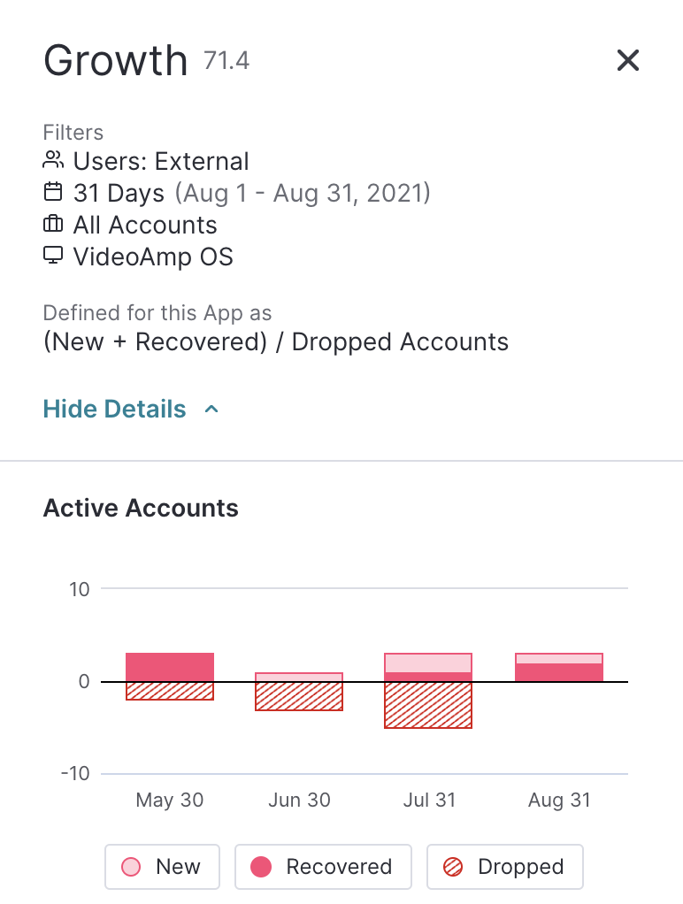
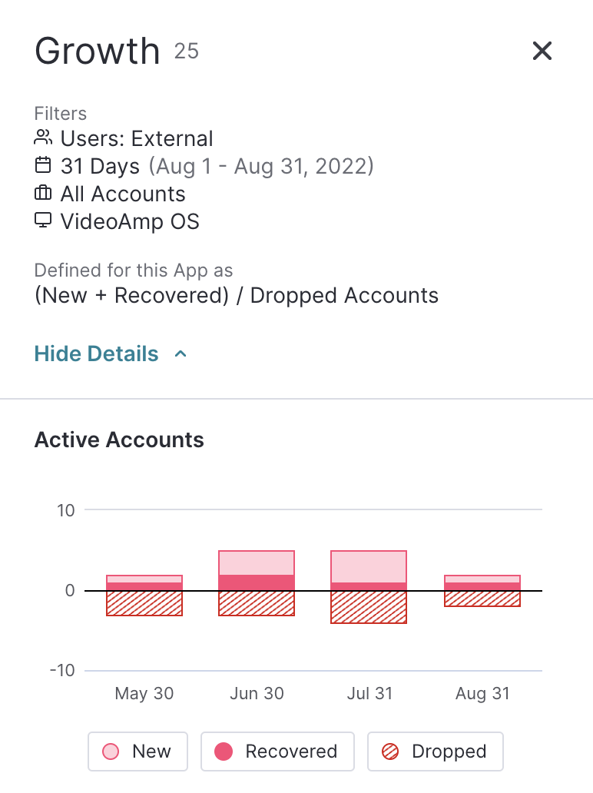
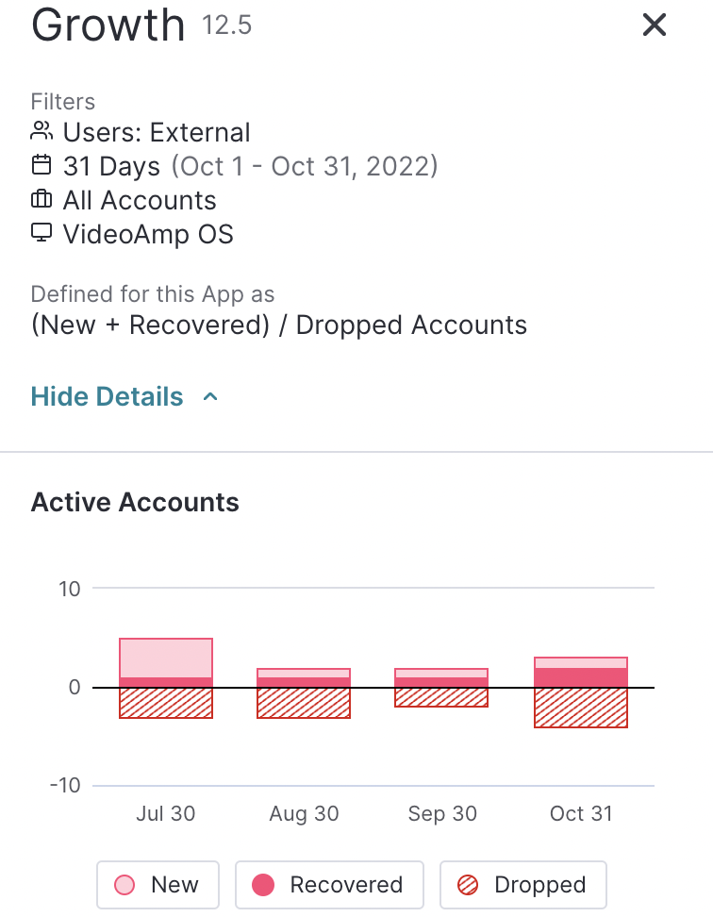
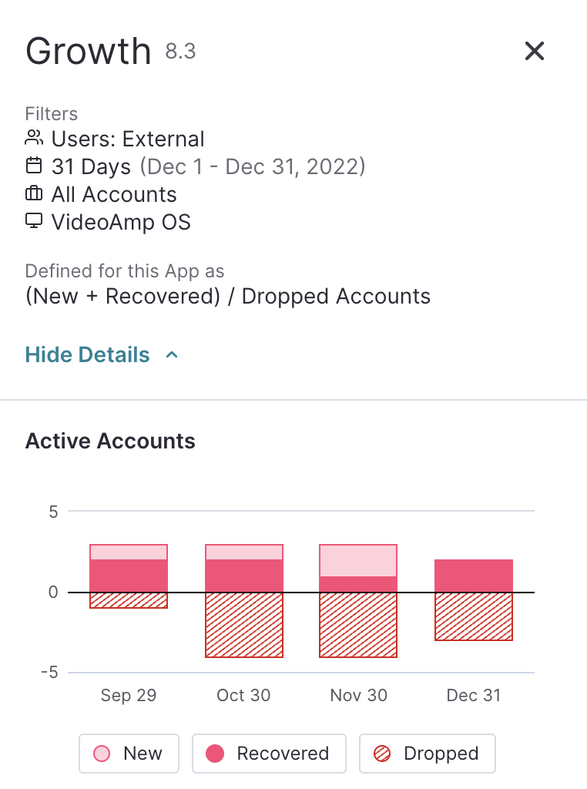
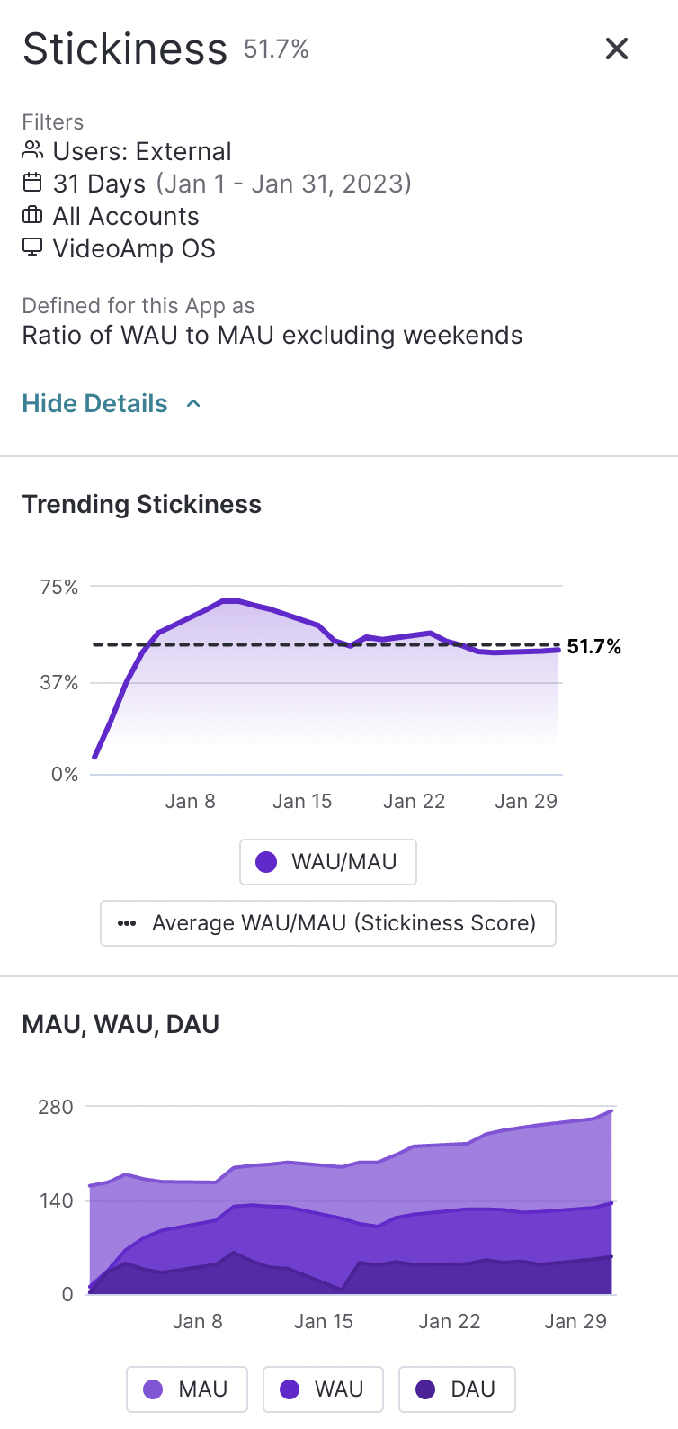
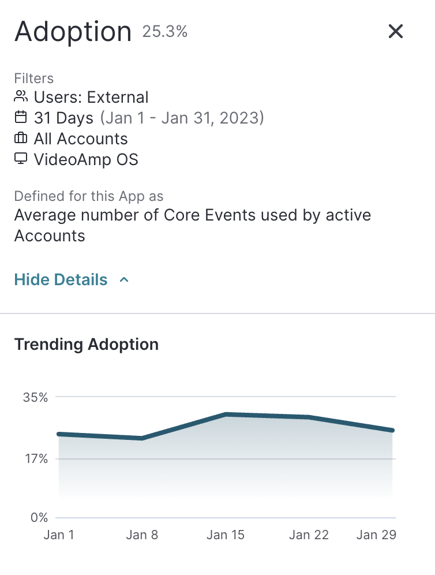
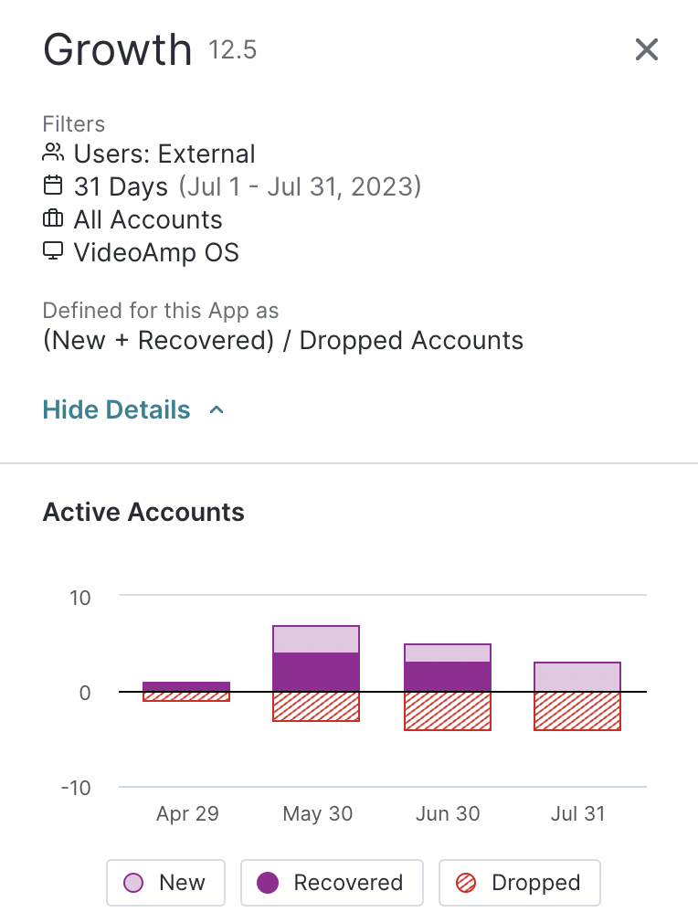
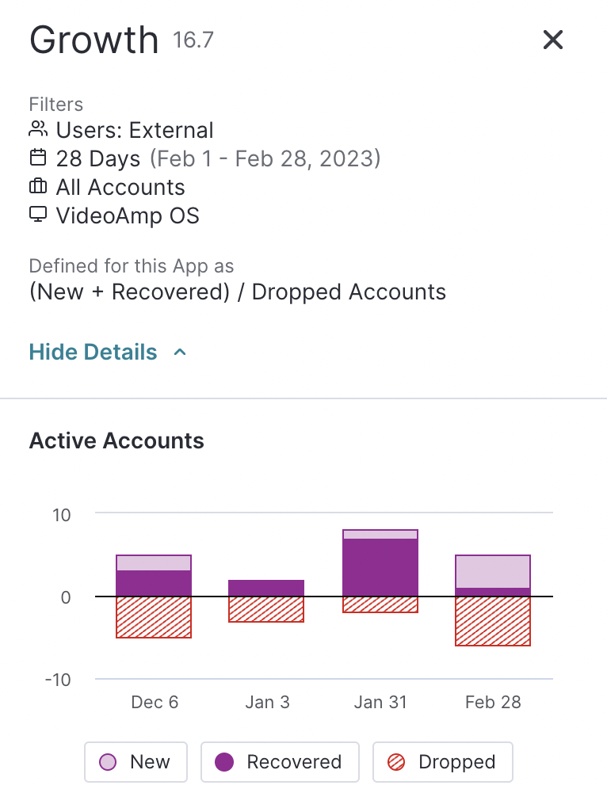
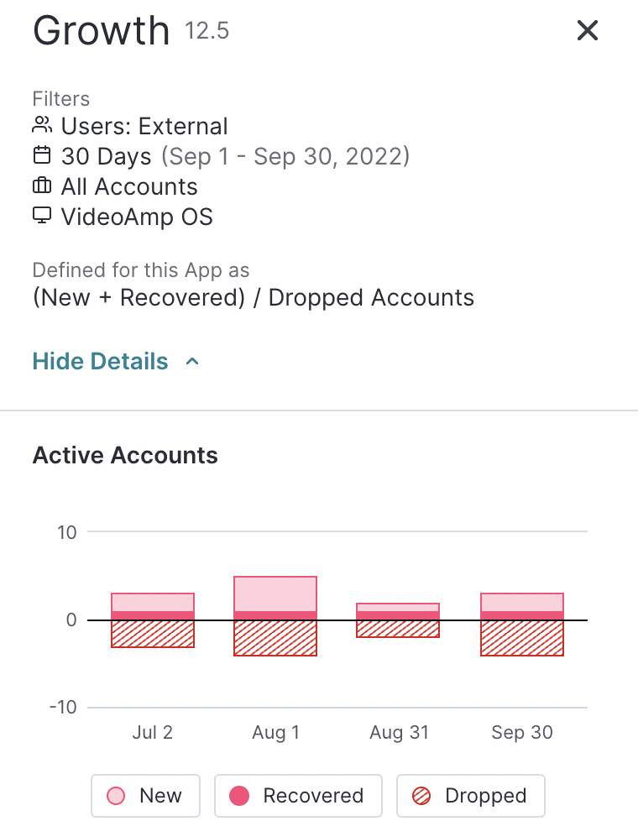
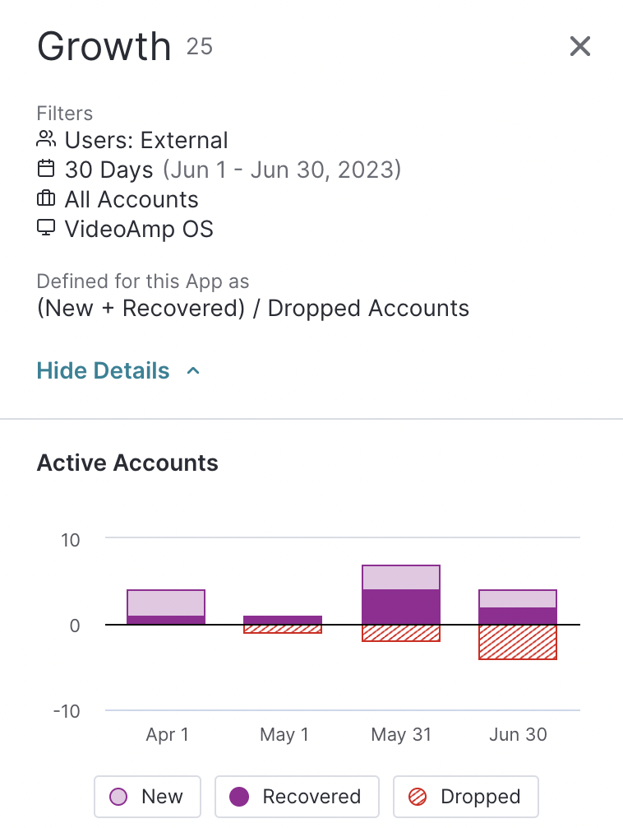
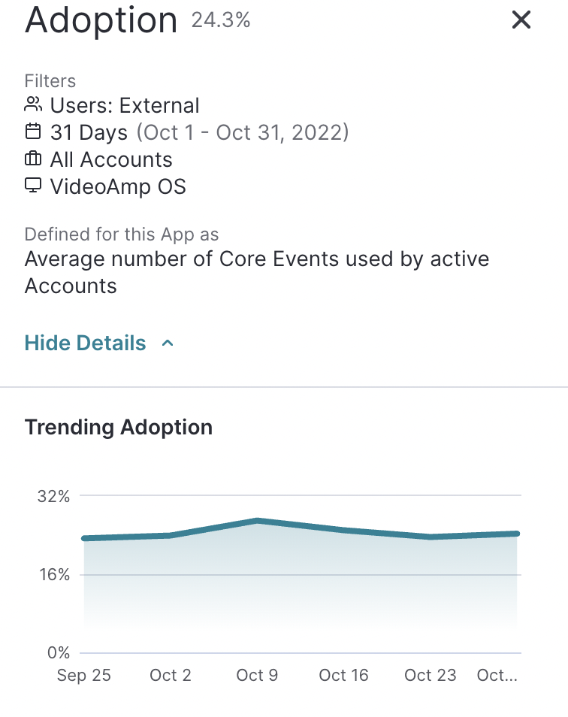
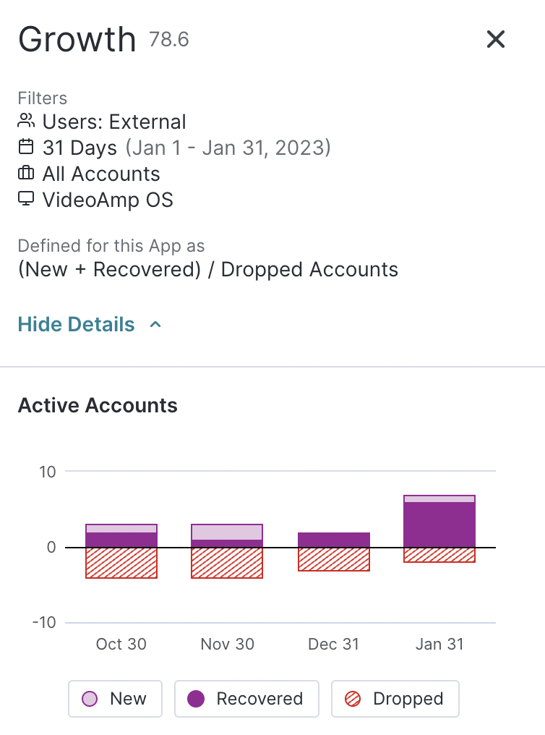
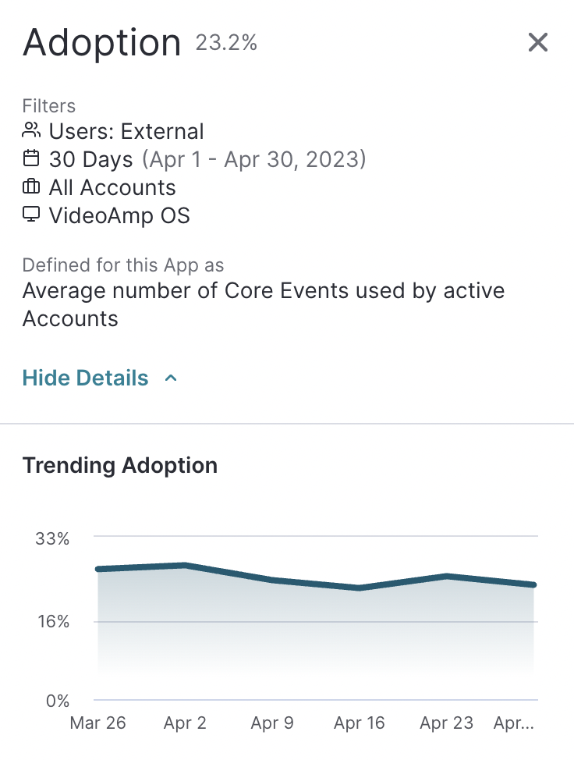
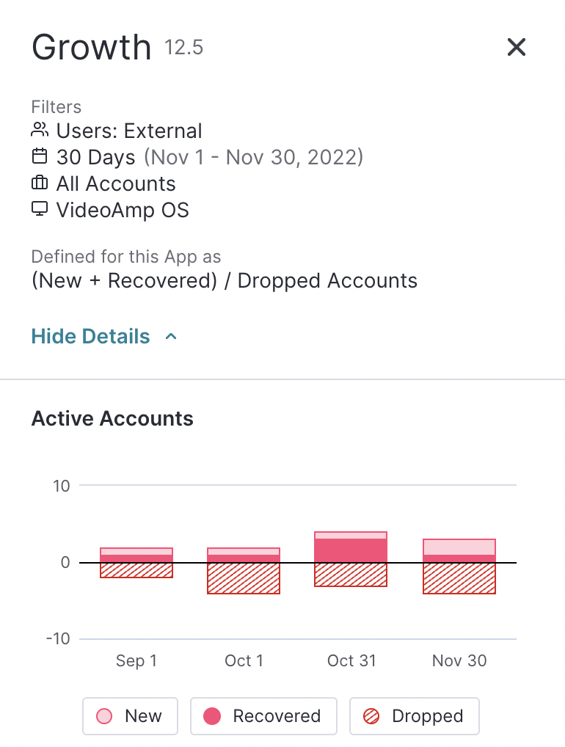
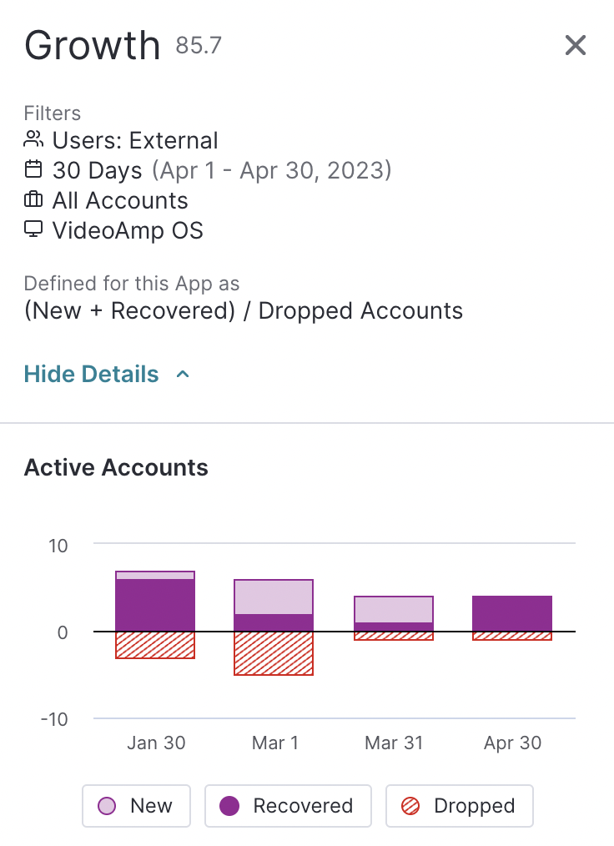
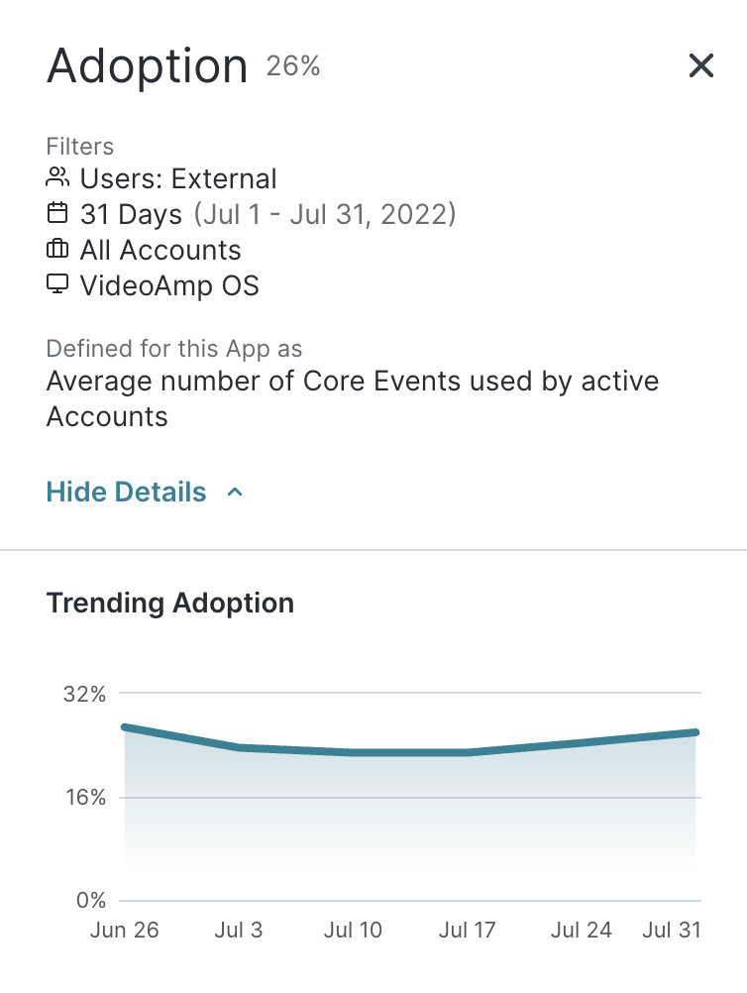
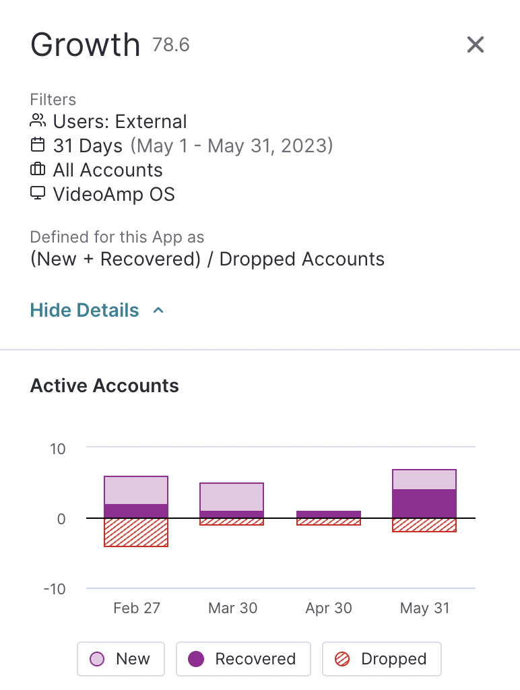
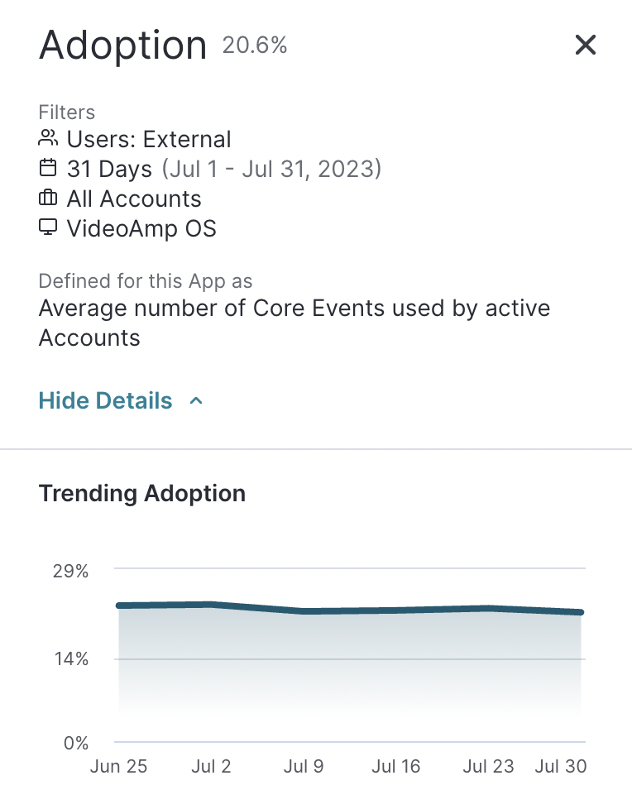
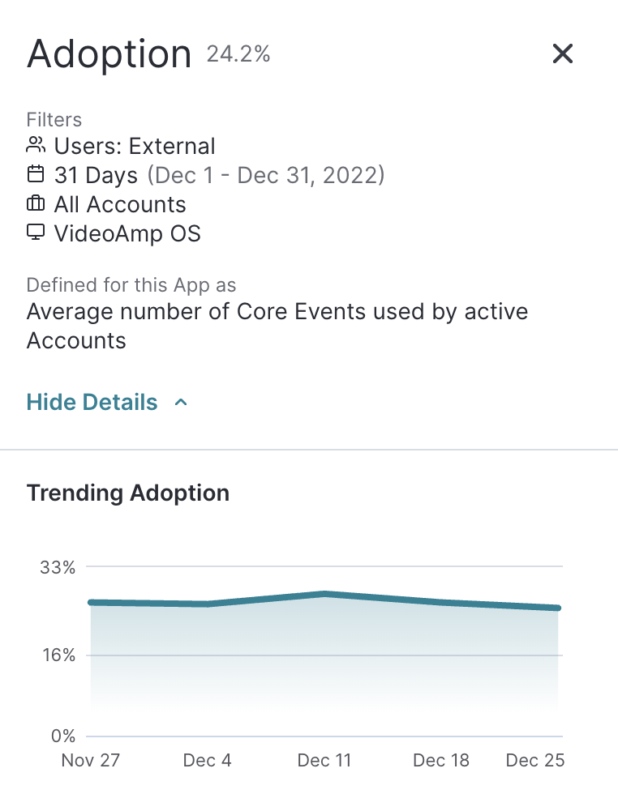
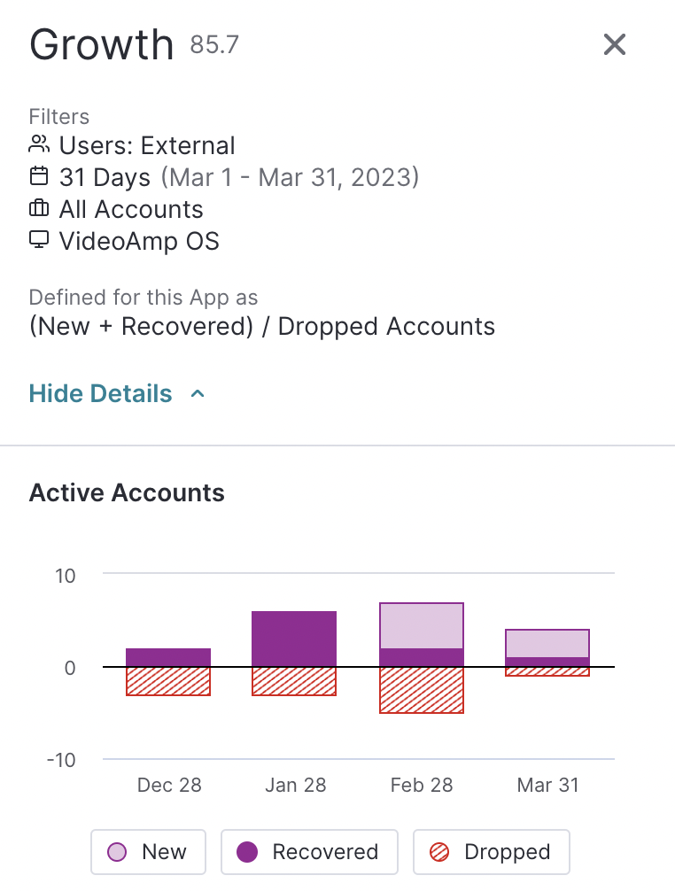
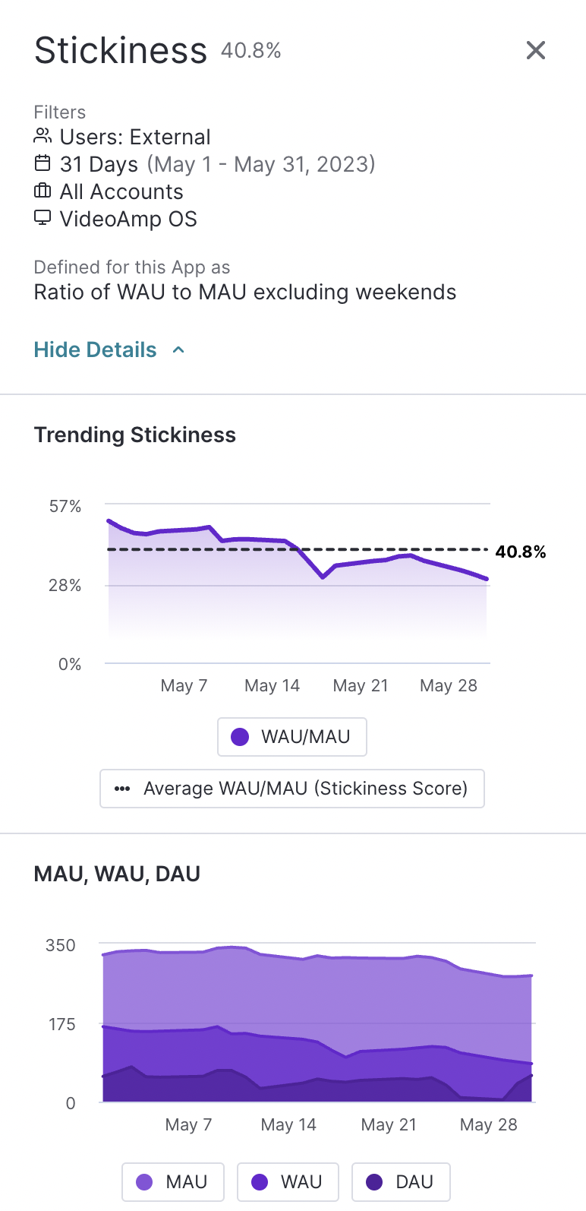
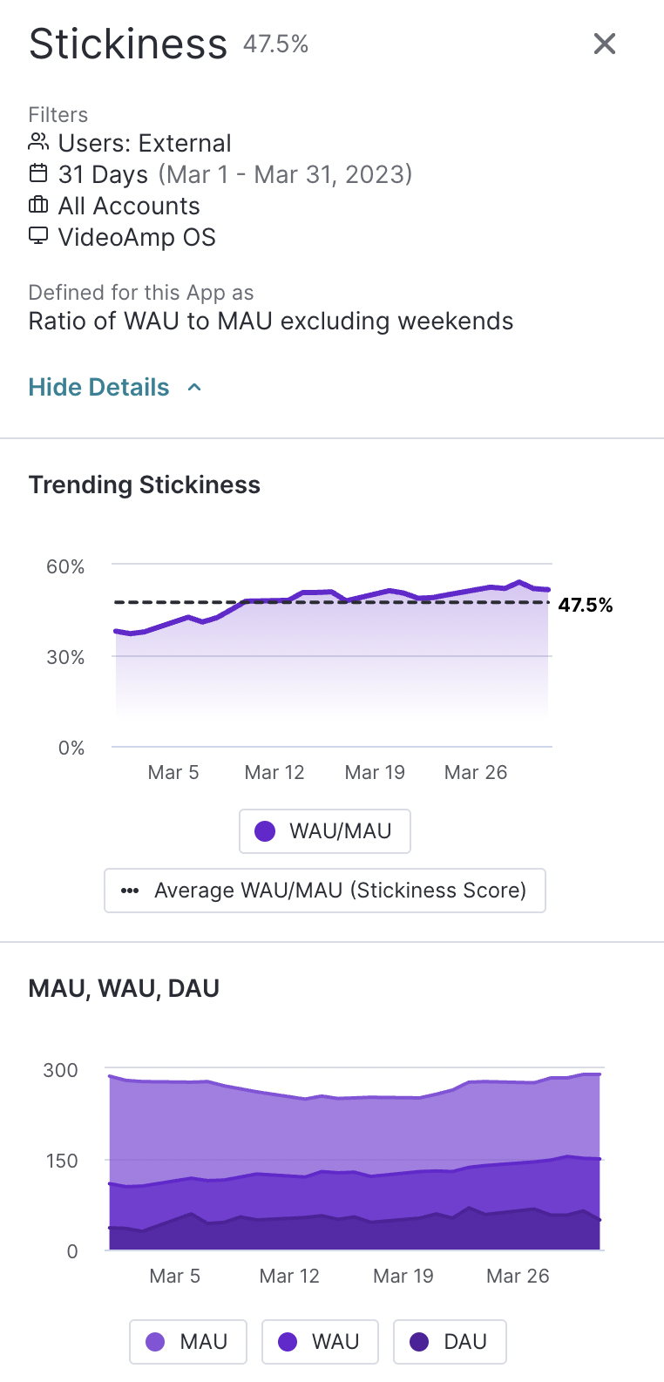
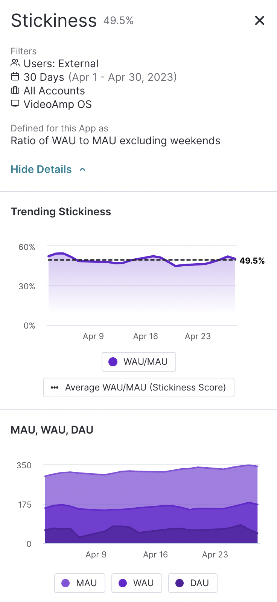
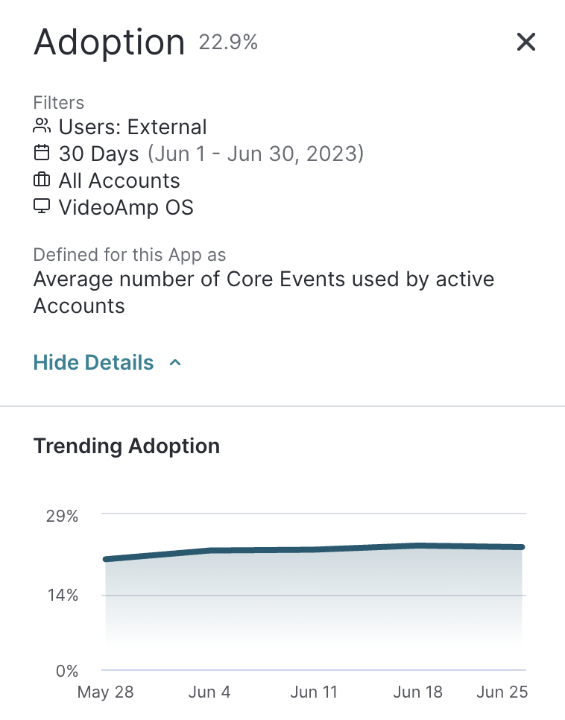
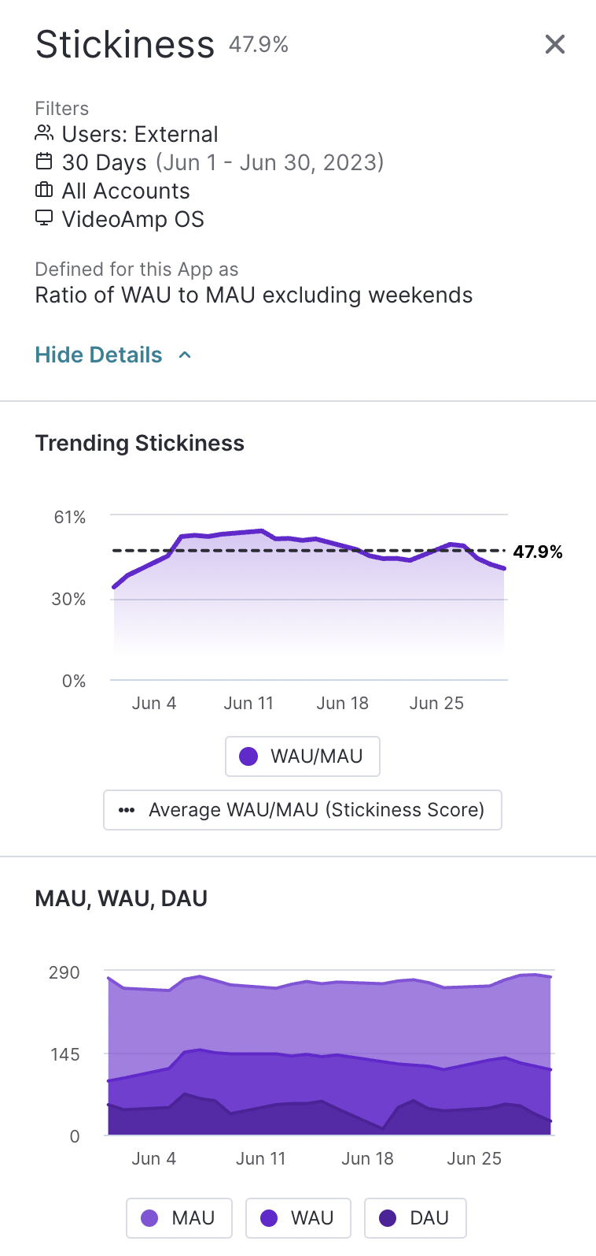
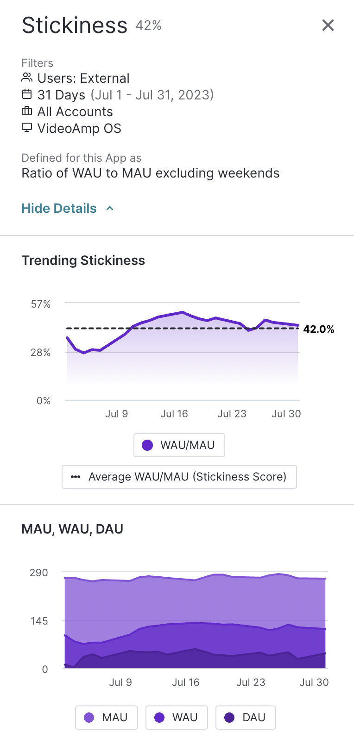
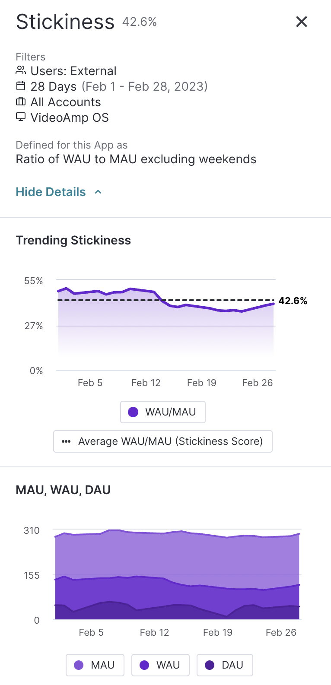
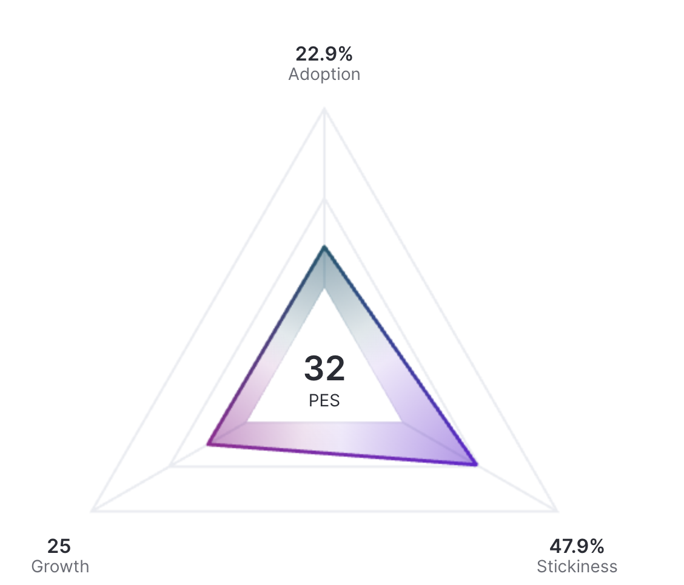
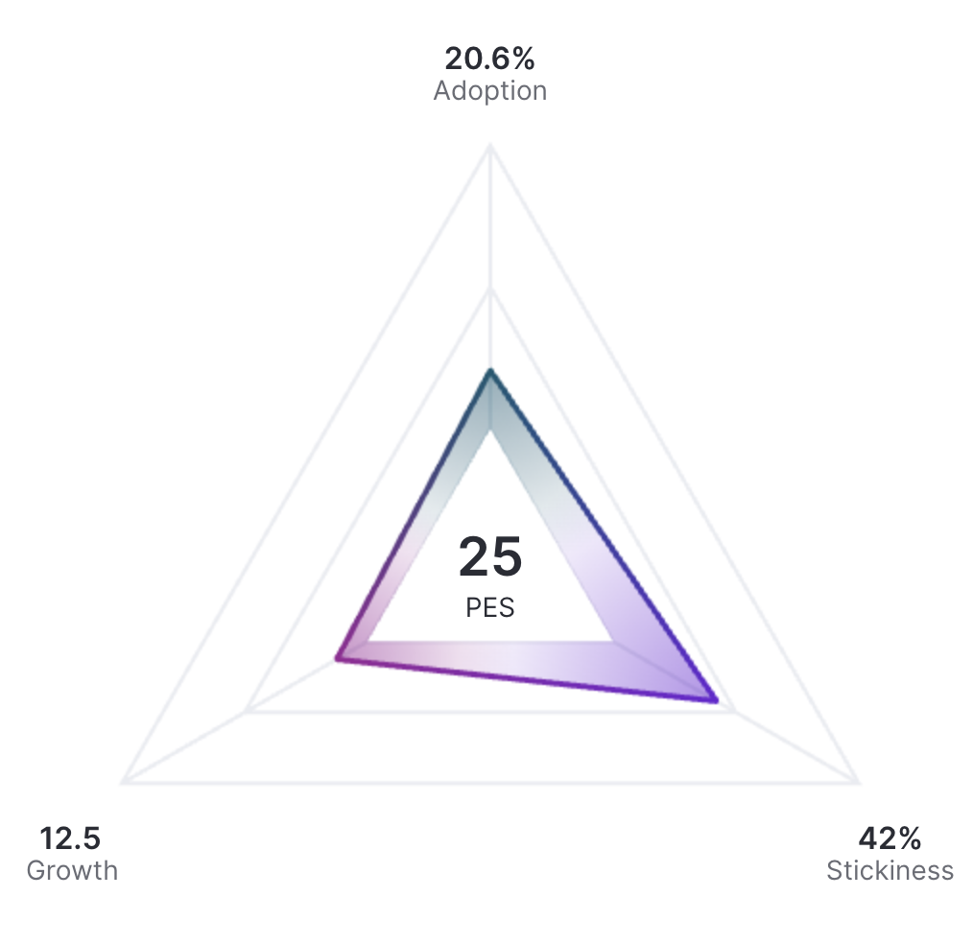
VideoAmp Product Engagement Score (PES)
December 2022
January 2023
February 2023
March 2023
April 2023
May 2023
June 2023
July 2023
Month, year
Product Engagement Score (PES) is a single number that represents the combined impact of feature adoption, return user stickiness, and new user growth.
* Core Events include Buy: Create Plan, Measure: Launch Initiative, Explore Initiative and Create Optimization Segment; Plan: Run Plan and Run Linear Buy

Slide 9
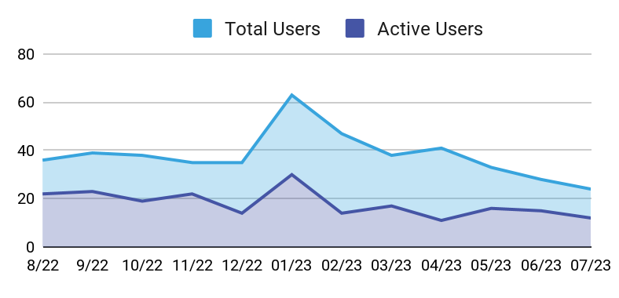
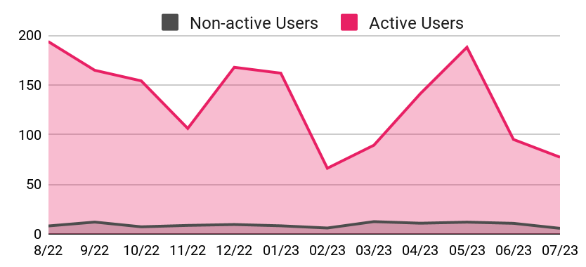
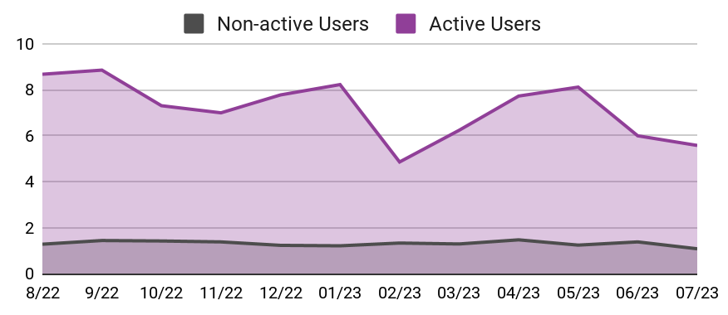
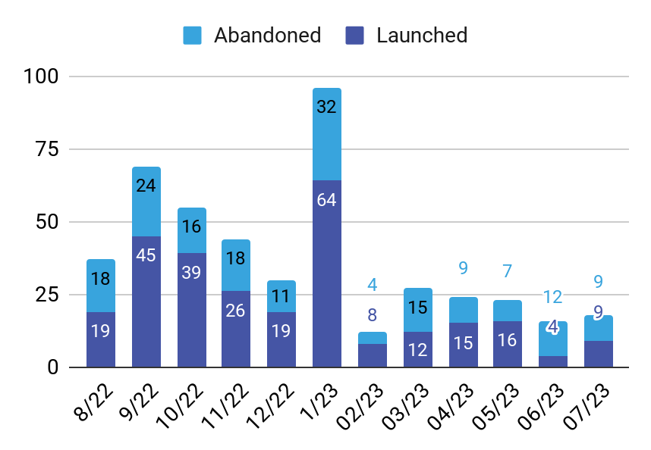
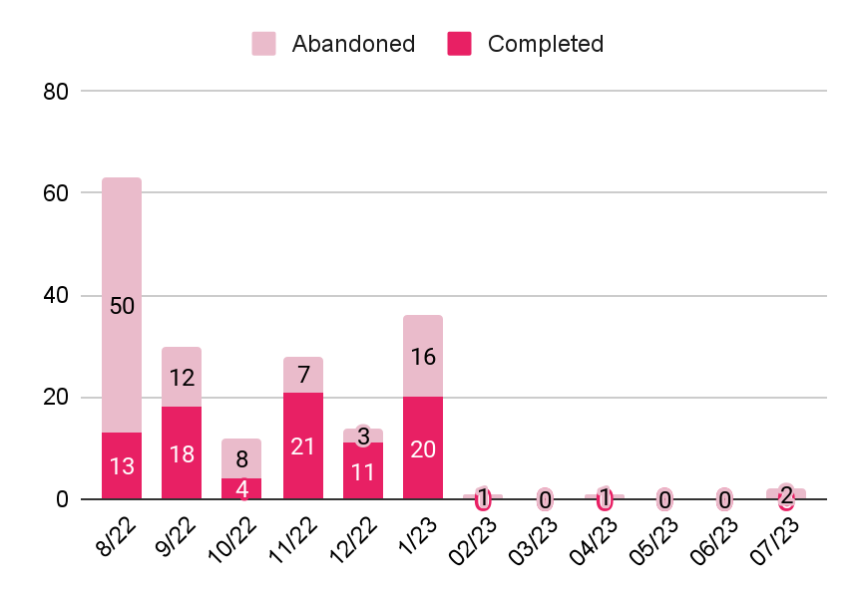
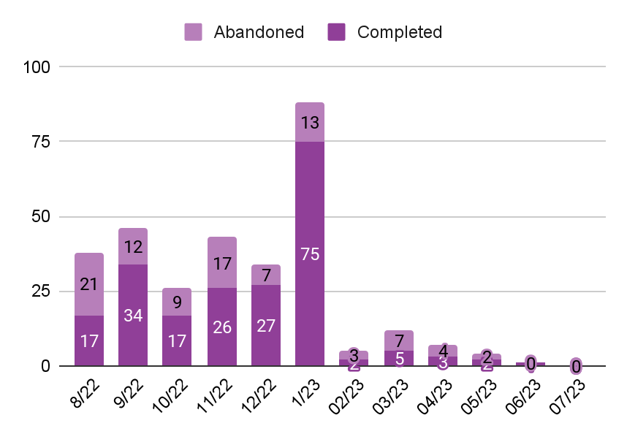
VideoAmp Platform Usage – Measurement Insight Users*
December 2022
January 2023
February 2023
March 2023
April 2023
May 2023
June 2023
July 2023
Month, year
24 / 12
Total MI Users / Active
41m 35s
Avg. Time Spent in Platform
3.33 days
Avg. Days Spent in Platform
Clients in the Platform
Avg. Time Spent In Platform
Avg. Days Spent In Platform
Initiatives: Launched vs. Abandoned
Linear Plans: Run vs. Abandoned
Audiences: Saved vs. Abandoned

Slide 10

VideoAmp Platform Organization Usage – Total Users
December 2022
January 2023
February 2023
March 2023
April 2023
May 2023
June 2023
July 2023
Month, year

Slide 11

VideoAmp Platform Organization Usage – Active Users
December 2022
January 2023
February 2023
March 2023
April 2023
May 2023
June 2023
July 2023
Month, year

Slide 12
Measure

Slide 13






Measure Usage
July 2023
Month, year
APP RATING: 7.00 / 10
APP RATING: 6.56 / 10
APP RATING: 6.95 / 10
APP RATING: 6.05 / 10
APP RATING: 7.06 / 10
APP RATING: 7.24 / 10
APP RATING: 6.95 / 10
APP RATING: 7.39 / 10
APP RATING: 7.27 / 10
APP RATING: 7.77 / 10
APP RATING: 7.64 / 10
APP RATING: 7.65 / 10
181 / 63 / 11
Total Users / Active / 1st-time Active
35m 48s
Avg. Time Spent in Measure
113
Initiatives Launched
723
Initiatives Explored
1.20
Avg Abandoned Initiatives
Clients in Measure app
Avg. Time Spent in Measure App (min)
Avg. Days Spent In Measure App
Initiatives: Launched & Abandoned
Initiatives: Explored
Average Abandoned Initiatives

Slide 14

Clients in the Measure App (YoY)
November 2022
December 2022
January 2022
January 2023
February 2023
March 2023
April 2023
May 2023
June 2023
July 2023
Month, year
APP RATING: 7.00 / 10
APP RATING: 6.56 / 10
APP RATING: 6.95 / 10
APP RATING: 6.05 / 10
APP RATING: 7.06 / 10
APP RATING: 7.24 / 10
APP RATING: 6.95 / 10
APP RATING: 7.39 / 10
APP RATING: 7.27 / 10
APP RATING: 7.77 / 10
APP RATING: 7.64 / 10
APP RATING: 7.65 / 10
Aug ‘21
Sep ‘21
Oct ‘21
Nov ‘21
Dec ‘21
Jan ‘22
Feb ‘22
Mar ‘22
Apr ‘22
May ‘22
Jun ‘22
Jul ‘22
Aug ‘22
Sep ‘22
Oct ‘22
Nov ‘22
Dec ‘22
Jan ‘23
Feb ‘23
Mar ‘23
Apr ‘23
May ‘23
Jun ‘23
Jul ‘23
250
200
150
100
50
0
50
100
150
200
250

Slide 15


Initiative Creation – Average vs. Median Time on Page
November 2022
December 2022
January 2022
January 2023
February 2023
March 2023
April 2023
May 2023
June 2023
July 2023
Month, year
APP RATING: 7.00 / 10
APP RATING: 6.56 / 10
APP RATING: 6.95 / 10
APP RATING: 6.05 / 10
APP RATING: 7.06 / 10
APP RATING: 7.24 / 10
APP RATING: 6.95 / 10
APP RATING: 7.39 / 10
APP RATING: 7.27 / 10
APP RATING: 7.77 / 10
APP RATING: 7.64 / 10
APP RATING: 7.65 / 10
Time on Page (min)
Number of Users

Slide 16



Initiative Creation – External Clients vs. Platform Solutions
November 2022
December 2022
January 2022
January 2023
February 2023
March 2023
April 2023
May 2023
June 2023
July 2023
Month, year
APP RATING: 7.00 / 10
APP RATING: 6.56 / 10
APP RATING: 6.95 / 10
APP RATING: 6.05 / 10
APP RATING: 7.06 / 10
APP RATING: 7.24 / 10
APP RATING: 6.95 / 10
APP RATING: 7.39 / 10
APP RATING: 7.27 / 10
APP RATING: 7.77 / 10
APP RATING: 7.64 / 10
APP RATING: 7.65 / 10
External Clients: Initiatives Created vs. Abandoned (YoY)
Initiatives Launched: External Clients vs. Platform Solutions Team
Aug ‘21
Sep ‘21
Oct ‘21
Nov ‘21
Dec ‘21
Jan ‘22
Feb ‘22
Mar ‘22
Apr ‘22
May ‘22
Jun ‘22
Jul ‘22
Aug ‘22
Sep ‘22
Oct ‘22
Nov ‘22
Dec ‘22
Jan ‘23
Feb ‘23
Mar ‘23
Apr ‘23
May ‘23
Jun ‘23
Jul ‘23
350
300
200
100
0
100
200
300
350
Hold Co. Initiatives Launched: External Clients vs. Platform Solutions Team

Slide 17
Initiative Abandonment (2 or more)
November 2022
December 2022
January 2022
January 2023
February 2023
March 2023
April 2023
May 2023
June 2023
July 2023
Month, year
APP RATING: 7.00 / 10
APP RATING: 6.56 / 10
APP RATING: 6.95 / 10
APP RATING: 6.05 / 10
APP RATING: 7.06 / 10
APP RATING: 7.24 / 10
APP RATING: 6.95 / 10
APP RATING: 7.39 / 10
APP RATING: 7.27 / 10
APP RATING: 7.77 / 10
APP RATING: 7.64 / 10
APP RATING: 7.65 / 10
Name | Org | Initiatives Abandoned
XXXXXX | XXX | 10
XXXXXX | XXX | 6
XXXXXX | XXX | 5
XXXXXX | XXX | 5
XXXXXX | XXX | 4
XXXXXX | XXX | 4
XXXXXX | XXX | 4
XXXXXX | XXX | 4
XXXXXX | XXX | 3
XXXXXX | XXX | 3

Slide 18

Initiative Exploration – Time Exploring Initiative Outputs
November 2022
December 2022
January 2022
January 2023
February 2023
March 2023
April 2023
May 2023
June 2023
July 2023
Month, year
APP RATING: 7.00 / 10
APP RATING: 6.56 / 10
APP RATING: 6.95 / 10
APP RATING: 6.05 / 10
APP RATING: 7.06 / 10
APP RATING: 7.24 / 10
APP RATING: 6.95 / 10
APP RATING: 7.39 / 10
APP RATING: 7.27 / 10
APP RATING: 7.77 / 10
APP RATING: 7.64 / 10
APP RATING: 7.65 / 10

Slide 19




Initiative Exploration – Average vs. Median Page Views
November 2022
December 2022
January 2022
January 2023
February 2023
March 2023
April 2023
May 2023
June 2023
July 2023
Month, year
APP RATING: 7.00 / 10
APP RATING: 6.56 / 10
APP RATING: 6.95 / 10
APP RATING: 6.05 / 10
APP RATING: 7.06 / 10
APP RATING: 7.24 / 10
APP RATING: 6.95 / 10
APP RATING: 7.39 / 10
APP RATING: 7.27 / 10
APP RATING: 7.77 / 10
APP RATING: 7.64 / 10
APP RATING: 7.65 / 10
External Usage
Platform Solutions Usage
Page Views
Number of Users
Number of Users
Page Views

Slide 20




Initiative Exploration – Average vs. Median Time on Page
November 2022
December 2022
January 2022
January 2023
February 2023
March 2023
April 2023
May 2023
June 2023
July 2023
Month, year
APP RATING: 7.00 / 10
APP RATING: 6.56 / 10
APP RATING: 6.95 / 10
APP RATING: 6.05 / 10
APP RATING: 7.06 / 10
APP RATING: 7.24 / 10
APP RATING: 6.95 / 10
APP RATING: 7.39 / 10
APP RATING: 7.27 / 10
APP RATING: 7.77 / 10
APP RATING: 7.64 / 10
APP RATING: 7.65 / 10
External Usage
Platform Solutions Usage
Time on Page
Time on Page
Number of Users
Number of Users

Slide 21
Initiative Exploration – Most Used Features*
November 2022
December 2022
January 2022
January 2023
February 2023
March 2023
April 2023
May 2023
June 2023
July 2023
Month, year
APP RATING: 7.00 / 10
APP RATING: 6.56 / 10
APP RATING: 6.95 / 10
APP RATING: 6.05 / 10
APP RATING: 7.06 / 10
APP RATING: 7.24 / 10
APP RATING: 6.95 / 10
APP RATING: 7.39 / 10
APP RATING: 7.27 / 10
APP RATING: 7.77 / 10
APP RATING: 7.64 / 10
APP RATING: 7.65 / 10
Feature Name | Feature Location | Number of Clicks | Number of Users
Overview Audience Open | Measure: Initiative: Overview - Audience | Open | 564 | 50
Performance Detail Open | Measure: Initiative - Performance | Detail | 516 | 84
Performance Breakdown Time Increment | Performance Breakdown: Time Increment | Open | 406 | 31
Conversion Date Range | Performance - Conversion | Date Range | 361 | 66
Attribution Discovery Select Dimension Dropdown | Attribution Discovery | Select Dimension Dropdown | 332 | 16
Performance Table Filter Toggle | Performance Detail - Table: Filter | Toggle | 234 | 17
Configure Digital Table | Delivery - Digital | Configure Table | 188 | 28
Performance Overlap | Performance | Overlap | 150 | 43
Performance Frequency | Performance | Frequency | 148 | 50
Frequency Filter Audience Open | Performance: Frequency - Filters: Audience | Open | 126 | 46
* Excludes downloads and features on the Index screen, within the initiative creation workflow, and within Help content.

Slide 22









Initiative Data Downloads
November 2022
December 2022
January 2022
January 2023
February 2023
March 2023
April 2023
May 2023
June 2023
July 2023
Month, year
APP RATING: 7.00 / 10
APP RATING: 6.56 / 10
APP RATING: 6.95 / 10
APP RATING: 6.05 / 10
APP RATING: 7.06 / 10
APP RATING: 7.24 / 10
APP RATING: 6.95 / 10
APP RATING: 7.39 / 10
APP RATING: 7.27 / 10
APP RATING: 7.77 / 10
APP RATING: 7.64 / 10
APP RATING: 7.65 / 10

Slide 23









Platform Solutions - Initiative Data Downloads
April 2023
May 2023
June 2023
July 2023
Month, year
APP RATING: 6.95 / 10
APP RATING: 7.39 / 10
APP RATING: 7.27 / 10
APP RATING: 7.77 / 10
APP RATING: 7.64 / 10
APP RATING: 7.65 / 10
March 2023

Slide 24


Measure: Rolling Six Month App Rating
December 2022
December 2022
January 2022
January 2023
February 2023
March 2023
April 2023
May 2023
June 2023
July 2023
Month, year
APP RATING: 7.65 / 10
7.65 (-0.12)
6 Month Avg. Score
8 /10
XXXXXX (OMG)
Measure App Scores (Dec - May)
Rolling Six Month Average Plan App Rating
Avg Daily Time Spent in Measure App (Min.)
User Scores
Clients who performed a significant action (e.g., build an initiative) or who visit screens within the app a minimum of 50 times are asked to answer the question “On a scale of 0-10, how effective was the Measure app at helping you accomplish your goals.”

Slide 25
Measure: Power Users
October 2022
December 2022
January 2022
January 2023
February 2023
March 2023
April 2023
May 2023
June 2023
July 2023
Month, year
APP RATING: 7.00 / 10
APP RATING: 6.56 / 10
APP RATING: 7.06 / 10
APP RATING: 7.24 / 10
APP RATING: 6.95 / 10
APP RATING: 7.39 / 10
APP RATING: 7.27 / 10
APP RATING: 7.77 / 10
APP RATING: 7.64 / 10
APP RATING: 7.65 / 10
Name | Org | Initiatives Created | Initiatives Launched | Initiatives Explored | Time Spent in App
XXXXXX | XXX | 12 | 8 | 37 | 14h 30m
XXXXXX | XXX | 12 | 7 | 59 | 4h 43m
XXXXXX | XXX | 25 | 21 | 26 | 2h 55m
XXXXXX | XXX | 11 | 10 | 11 | 2h 35m
XXXXXX | XXX | 5 | 5 | 10 | 1h 58m
XXXXXX | XXX | 0 | 0 | 34 | 2h 45m
XXXXXX | XXX | 1 | 0 | 28 | 4h 29m
XXXXXX | XXX | 0 | 0 | 19 | 2h 47m
XXXXXX | XXX | 7 | 0 | 19 | 1h 44m
XXXXXX | XXX | 0 | 0 | 17 | 2h 03m
XXXXXX | XXX | 0 | 0 | 16 | 1h 49m
XXXXXX | XXX | 3 | 1 | 16 | 1h 20m

Slide 26
Linear Plan

Slide 27





Linear Plan Usage
October 2022
December 2022
January 2022
January 2023
February 2023
March 2023
April 2023
May 2023
June 2023
July 2023
Month, year
APP RATING: 8.66 / 10
APP RATING: 8.00 / 10
APP RATING: 9.00 / 10
APP RATING: 8.75 / 10
APP RATING: 6.25 / 10
APP RATING: 5.00 / 10
APP RATING: 4.14 / 10
APP RATING: 4.50 / 10
APP RATING: 5.42 / 10
69 / 17 / 5
Total Users / Active / 1st-time Active
13m 10s
Avg. Time Spent in Plan
43
Linear Plans Run
152
Linear Plans Explored
0
Linear Buys
0
Aggregate Buys
Clients in Linear Plan App
Avg. Time Spent in Linear Plan App (min)
Avg. Days Spent in Linera Plan App
Linear Plans: Run vs. Abandoned
Linear Plans: Explored

Slide 28

Linear Plan Exploration – Time Exploring Plan Outputs
November 2022
December 2022
January 2022
January 2023
February 2023
March 2023
April 2023
May 2023
June 2023
July 2023
Month, year
APP RATING: 8.50 / 10
APP RATING: 8.00 / 10
APP RATING: 9.00 / 10
APP RATING: 8.75 / 10
APP RATING: 6.25 / 10
APP RATING: 5.00 / 10
APP RATING: 4.14 / 10
APP RATING: 4.50 / 10
APP RATING: 5.42 / 10

Slide 29



Linear Plan – External Clients vs. Platform Solutions Team
November 2022
December 2022
January 2022
January 2023
February 2023
March 2023
April 2023
May 2023
June 2023
July 2023
Month, year
APP RATING: 7.00 / 10
APP RATING: 6.56 / 10
APP RATING: 6.95 / 10
APP RATING: 6.05 / 10
APP RATING: 7.06 / 10
APP RATING: 7.24 / 10
APP RATING: 6.95 / 10
APP RATING: 5.00 / 10
APP RATING: 4.14 / 10
APP RATING: 4.50 / 10
APP RATING: 5.42 / 10
External Clients: Plans Run vs. Abandoned (YoY)
Plans Run: External Clients vs. Platform Solutions Team
Aug ‘21
Sep ‘21
Oct ‘21
Nov ‘21
Dec ‘21
Jan ‘22
Feb ‘22
Mar ‘22
Apr ‘22
May ‘22
Jun ‘22
Jul ‘22
Aug ‘22
Sep ‘22
Oct ‘22
Nov ‘22
Dec ‘22
Jan ‘23
Feb ‘23
Mar ‘23
Apr ‘23
May ‘23
Jun ‘23
Jul ‘23
200
100
0
100
200
Linear Plans Launched by Hold Co.: External Clients vs. Platform Solutions Team

Slide 30


Linear Plan Exploration – Average vs. Median Page Views
November 2022
December 2022
January 2022
January 2023
February 2023
March 2023
April 2023
May 2023
June 2023
July 2023
Month, year
APP RATING: 8.50 / 10
APP RATING: 8.00 / 10
APP RATING: 9.00 / 10
APP RATING: 8.75 / 10
APP RATING: 6.25 / 10
APP RATING: 5.00 / 10
APP RATING: 4.14 / 10
APP RATING: 4.50 / 10
APP RATING: 5.42 / 10
Page Views
Number of Users

Slide 31


Linear Plan Exploration – Average vs. Median Time on Page
November 2022
December 2022
January 2022
January 2023
February 2023
March 2023
April 2023
May 2023
June 2023
July 2023
Month, year
APP RATING: 8.50 / 10
APP RATING: 8.00 / 10
APP RATING: 9.00 / 10
APP RATING: 8.75 / 10
APP RATING: 6.25 / 10
APP RATING: 5.00 / 10
APP RATING: 4.14 / 10
APP RATING: 4.50 / 10
APP RATING: 5.42 / 10
Time on Page
Number of Users

Slide 32


Linear Plan: Rolling Six Month App Rating
November 2022
December 2022
January 2022
January 2023
February 2023
March 2023
April 2023
May 2023
June 2023
July 2023
Month, year
APP RATING: 5.42 / 10
5.42 (+0.92)
6 Month Avg. Score
10 /10
Megan Carragher (OMG)
10 /10
Megan Eney (OMG)
Plan App Scores (Sep - Feb)
Rolling Six Month Average Plan App Rating
Avg Daily Time Spent in Plan App (Min.)
User Scores
Clients who performed a significant action (e.g., build a plan) or who visit screens within the app a minimum of 50 times are asked to answer the question “On a scale of 0-10, how effective was the Plan app at helping you accomplish your goals.”

Slide 33
Linear Plan: Power Users
October 2022
December 2022
January 2022
January 2023
February 2023
March 2023
April 2023
May 2023
June 2023
July 2023
Month, year
APP RATING: 7.00 / 10
APP RATING: 6.56 / 10
APP RATING: 6.05 / 10
APP RATING: 8.75 / 10
APP RATING: 6.25 / 10
APP RATING: 5.00 / 10
APP RATING: 4.14 / 10
APP RATING: 4.50 / 10
APP RATING: 5.42 / 10
Name | Org | Plans Created | Plans Run | Plans Explored | Time Spent in App
XXXXXX | XXX | 11 | 8 | 22 | 2h 09m
XXXXXX | XXX | 4 | 4 | 20 | 58m

Slide 34
Cross Platform Plan

Slide 35





Cross Platform Plan Usage
November 2022
December 2022
January 2022
January 2023
February 2023
March 2023
April 2023
May 2023
June 2023
July 2023
Month, year
APP RATING: 9.00 / 10
APP RATING: 9.50 / 10
APP RATING: 9.67 / 10
APP RATING: 9.25 / 10
APP RATING: 8.00 / 10
49 / 12 / 4
Total Users / Active / 1st-time Active
45m 40s
Avg. Time Spent in Buy
66
Created Plans
26
Run Plans
379
Explored Plans
Clients in CPP App
Avg. Time Spent In CPP App (min)
Avg. Days Spent In CPP App
Investment Plans: Run vs. Abandoned
Investment Plans: Explored
* September 2021 data was impacted by a Pendo data collection issue that caused an eight day blackout.

Slide 36



Cross Platform Plan – External Clients vs. Platform Solutions
November 2022
December 2022
January 2022
January 2023
February 2023
March 2023
April 2023
May 2023
June 2023
July 2023
Month, year
APP RATING: 7.00 / 10
APP RATING: 6.56 / 10
APP RATING: 6.95 / 10
APP RATING: 6.05 / 10
APP RATING: 7.06 / 10
APP RATING: 7.24 / 10
APP RATING: 6.95 / 10
APP RATING: 9.67 / 10
APP RATING: 9.25 / 10
APP RATING: 8.00 / 10
External Clients: Cross Platform Plans Launched vs. Abandoned (YoY)
Cross Platform Plans Launched: External Clients vs. Platform Solutions Team
Aug ‘21
Sep ‘21
Oct ‘21
Nov ‘21
Dec ‘21
Jan ‘22
Feb ‘22
Mar ‘22
Apr ‘22
May ‘22
Jun ‘22
Jul ‘22
Aug ‘22
Sep ‘22
Oct ‘22
Nov ‘22
Dec ‘22
Jan ‘23
Feb ‘23
Mar ‘23
Apr ‘23
May ‘23
Jun ‘23
Jul ‘23
200
100
0
100
200
Cross Platform Plans Launched by Hold Co.: External Clients vs. Platform Solutions Team

Slide 37


Cross Platform Plan: App Rating
November 2022
December 2022
January 2022
January 2023
February 2023
March 2023
April 2023
May 2023
June 2023
July 2023
Month, year
APP RATING: 8.00 / 10
8.00
6 Month Avg. Score
5 /10
Jennifer Cherrywoode (Resolution)
(-1.25)
Cross Platform Plan App Scores (Sep - Feb)
Rolling Six Month Average Cross Platform Planner App Rating
Avg Daily Time Spent in App (Min.)
User Scores
Clients who performed a significant action (e.g., build an audience) or who visit screens within the app a minimum of 50 times are asked to answer the question “On a scale of 0-10, how effective was the Audience app at helping you accomplish your goals.”

Slide 38
Cross Platform Plan: Power Users
November 2022
December 2022
January 2022
January 2023
February 2023
March 2023
April 2023
May 2023
June 2023
July 2023
Month, year
APP RATING: 9.00 / 10
APP RATING: 9.50 / 10
APP RATING: 9.67 / 10
APP RATING: 9.25 / 10
APP RATING: 8.00 / 10
Name | Org | Plans Created | Plans Run | Plans Explored | Time Spent in App
XXXXXX | XXX | 14 | 5 | 149 | 10h 15m
XXXXXX | XXX | 7 | 7 | 56 | 5h 53m
XXXXXX | XXX | 7 | 5 | 20 | 5h 42m
XXXXXX | XXX | 0 | 0 | 51 | 2h 43m
XXXXXX | XXX | 2 | 1 | 18 | 2h 12m
XXXXXX | XXX | 2 | 1 | 17 | 1h 12m
XXXXXX | XXX | 0 | 0 | 15 | 1h 31m
XXXXXX | XXX | 5 | 2 | 11 | 1h 08m

Slide 39
Audiences

Slide 40






Audience Usage
November 2022
December 2022
January 2022
January 2023
February 2023
March 2023
April 2023
May 2023
June 2023
July 2023
Month, year
APP RATING: 9.17 / 10
APP RATING: 9.17 / 10
APP RATING: 9.43 / 10
APP RATING: 9.33 / 10
APP RATING: 8.16 / 10
APP RATING: 8.14 / 10
APP RATING: 8.33 / 10
APP RATING: 6.29 / 10
APP RATING: 5.50 / 10
APP RATING: 6.00 / 10
70 / 9 / 4
Total Users / Active / 1st-time Active
5m 25s
Avg. Time Spent in Audience
205
Started Audiences
164
Saved Audiences
110
Explored Audiences
4
TV Viewership Segments
Clients in the Audience App
Avg. Time Spent In Audience App (min)
Avg. Days Spent In Audience App
Audiences: Saved vs. Abandoned
Audiences: Explored
TV Viewership & Optimization Segments: Created

Slide 41



Audiences – External Clients vs. Platform Solutions
November 2022
December 2022
January 2022
January 2023
February 2023
March 2023
April 2023
May 2023
June 2023
July 2023
Month, year
APP RATING: 7.00 / 10
APP RATING: 6.56 / 10
APP RATING: 6.95 / 10
APP RATING: 6.05 / 10
APP RATING: 7.06 / 10
APP RATING: 7.24 / 10
APP RATING: 6.95 / 10
APP RATING: 6.29 / 10
APP RATING: 5.50 / 10
APP RATING: 6.00 / 10
External Clients: Audiences Created vs. Abandoned (YoY)
Audiences Created: External Clients vs. Platform Solutions Team
Aug ‘21
Sep ‘21
Oct ‘21
Nov ‘21
Dec ‘21
Jan ‘22
Feb ‘22
Mar ‘22
Apr ‘22
May ‘22
Jun ‘22
Jul ‘22
Aug ‘22
Sep ‘22
Oct ‘22
Nov ‘22
Dec ‘22
Jan ‘23
Feb ‘23
Mar ‘23
Apr ‘23
May ‘23
Jun ‘23
Jul ‘23
-250
-200
-100
0
100
200
250
Audiences Created by Hold Co.: External Clients vs. Platform Solutions Team

Slide 42


Audience: App Rating
November 2022
December 2022
January 2022
January 2023
February 2023
March 2023
April 2023
May 2023
June 2023
July 2023
Month, year
APP RATING: 6.00 / 10
5.50
6 Month Avg. Score
No New Reviews
Audience App Scores (Aug - Jan)
Rolling Six Month Average Audience App Rating
Avg Daily Time Spent in App (Min.)
User Scores
Clients who performed a significant action (e.g., build an audience) or who visit screens within the app a minimum of 50 times are asked to answer the question “On a scale of 0-10, how effective was the Audience app at helping you accomplish your goals.”

Slide 43
Audience: Power Users
November 2022
December 2022
January 2022
January 2023
February 2023
March 2023
April 2023
May 2023
June 2023
Month, year
APP RATING: 9.17 / 10
APP RATING: 9.43 / 10
APP RATING: 9.33 / 10
APP RATING: 8.16 / 10
APP RATING: 8.14 / 10
APP RATING: 8.33 / 10
APP RATING: 6.29 / 10
APP RATING: 5.50 / 10
APP RATING: 6.00 / 10
Name | Org | Audiences Started | Audiences Completed | Audiences Explored | Viewership Segments Started | Viewership Segments Completed | Time Spent in App
XXXXXX | XXX | 153 | 141 | 5 | 0 | 0 | 5h 19m
XXXXXX | XXX | 14 | 8 | 49 | 0 | 0 | 2h 33m
XXXXXX | XXX | 6 | 2 | 12 | 0 | 0 | 1h 35m

Slide 44
Elsy Usage

Slide 45



Elsy Usage
July 2023
Month, year
50 / 31
Total Users / Active
2h 06m
Avg. Time Spent in PMB
Clients in the Elsy Platform
Avg. Time Spent in the Elsy Platform (min)
Avg. Days Spent In Elsy Platform
Top Users by Time in Elsy Platform
Top Users by Days in Elsy Platform
Rank | User | Org | Time
1 | XXXXXX | XXX | 48h 21m
2 | XXXXXX | XXX | 14h 12m
3 | XXXXXX | XXX | 5h 33m
4 | XXXXXX | XXX | 4h 17m
5 | XXXXXX | XXX | 3h 54m
Rank | User | Org | Days
1 | XXXXXX | XXX | 14
2 | XXXXXX | XXX | 13
3 | XXXXXX | XXX | 13
4 | XXXXXX | XXX | 13
5 | XXXXXX | XXX | 12

Slide 46


Elsy - Plan Overview Reports
November 2022
December 2022
January 2023
February 2023
March 2023
April 2023
May 2023
June 2023
July 2023
Month, year
20
Total Users
7m 15s
Avg. Time Spent in Report
Plan Overview Report: Total Users
Plan Overview Report: Top Users
Rank | User | Org | Time on Report
1 | XXXXXX | XXX | 34m
2 | XXXXXX | XXX | 22m
3 | XXXXXX | XXX | 22m
4 | XXXXXX | XXX | 15m
Plan Overview Report: Avg. Time per User (min)

Slide 47


Elsy - Plan Comparison Reports
November 2022
December 2022
January 2023
February 2023
March 2023
April 2023
May 2023
June 2023
July 2023
Month, year
21
Total Users
1h 9m
Avg. Time Spent in Report
Plan Comparison Report: Total Users
Plan Comparison Report: Top Users
Rank | User | Org | Time on Report
1 | XXXXXX | XXX | 12h 39m
2 | XXXXXX | XXX | 2h 23m
3 | XXXXXX | XXX | 1h 38m
4 | XXXXXX | XXX | 57m
5 | XXXXXX | XXX | 47m
Plan Comparison Report: Avg. Time per User (min)

Slide 48


Elsy - Campaign Performance Reports
November 2022
December 2022
January 2023
February 2023
March 2023
April 2023
May 2023
June 2023
July 2023
Month, year
12
Total Users
44m 53s
Avg. Time Spent in Report
Campaign Performance Report: Total Users
Campaign Performance Report: Top Users
Rank | User | Org | Time on Report
1 | XXXXXX | XXX | 2h 49m
2 | XXXXXX | XXX | 2h 47m
3 | XXXXXX | XXX | 1h 00m
4 | XXXXXX | XXX | 54m
5 | XXXXXX | XXX | 32m
Campaign Performance Report: Avg. Time per User (min)

Slide 49


Elsy - Campaign Monitoring Reports
November 2022
December 2022
January 2023
February 2023
March 2023
April 2023
May 2023
June 2023
July 2023
Month, year
11
Total Users
13m 17s
Avg. Time Spent in Report
Campaign Monitoring Report: Total Users
Campaign Monitoring Report: Top Users
Rank | User | Org | Time on Report
1 | XXXXXX | XXX | 35m
2 | XXXXXX | XXX | 31m
3 | XXXXXX | XXX | 26m
4 | XXXXXX | XXX | 26m
5 | XXXXXX | XXX | 16m
Campaign Monitoring Report: Avg. Time per User (min)

Slide 50




Elsy Platform Exploration – Average vs. Median Page Views*
November 2022
December 2022
January 2023
February 2023
March 2023
April 2023
May 2023
June 2023
July 2023
Month, year
External Usage
Delivery Team Usage
Page Views
Number of Users
Page Views
Number of Users
* Includes all related pages contained within the listed section of the platform.

Slide 51




Elsy Platform Exploration – Average vs. Median Total Time on Page*
November 2022
December 2022
January 2023
February 2023
March 2023
April 2023
May 2023
June 2023
July 2023
Month, year
External Usage
Delivery Team Usage
Time on Page
Number of Users
* Includes time spent on all related pages contained within the listed section of the platform.

Slide 52
Tableau Usage

Slide 53




Tableau Usage
November 2022
December 2022
January 2023
February 2023
March 2023
April 2023
May 2023
June 2023
July 2023
Month, year
110 / 40
Total Tableau Users / Active
3.55 days
Avg. Days in Tableau
2130
Reports Accessed
Clients in Tableau
Avg. Days Spent In Tableau
Platform Only Users
260
Total Reports Accessed
CARD Total Reports Accessed
Platform & Tableau Users
9
Tableau Only Users 101

Slide 54






CARD Report Usage*
November 2022
December 2022
January 2023
February 2023
March 2023
April 2023
May 2023
June 2023
Month, year
12 / 2
Total CARD Users / Active
1.83 days
Avg. Days in Tableau
59
Reports Accessed
Audience by Telecast, Daypart
Daypart, Program, Telecast views
Network Views
Program Views
Ranker
Trending Metrics By Daypart
* The charts on this slide highlight the number of users who have accessed the various tabs of the CARD Tableau report.

Slide 55
Appendix

Slide 56
Definitions
Platform Total Users – Any non-VideoAmp user who logged into the platform during the course of the month, regardless of time spent or activity.
Platform Active Users – Any non-VideoAmp user who has accessed the platform on at least three different days over the course of the month.
App (e.g., Measure) Total Users – Any non-VideoAmp user who has accessed the app and performed at least one significant action (e.g., explore an initiative) that took them beyond the initial index screen.
Active App (e.g., Measure) Users – Any non-VideoAmp user who meets the general App Total User criteria and has accessed the app in question on at least three different days over the course of the month.
1st-time Active Users – Any non-VideoAmp user who meets the Active User requirements for the first time since we began tracking these numbers in May, 2020.
Power Users:
Measure – Launches 5 or more initiatives AND/OR explores 10 or more initiatives
Plan – Runs 5 or more plans AND/OR runs 5 or more Linear Buys AND/OR runs 5 or more aggregate buys AND/OR explores 15 or more plans
Buy – Runs 5 or more plans AND/OR explores 10 or more plans
Audiences – Builds 5 or more audiences AND/OR explores 10 or more audiences
Allocation – Runs 4 or more allocations AND/OR explores 8 or more allocations

Slide 57
Thank You

